Slide 1
Arnie erythrocyte saves the day
I am the oxygenator I am deoxygenated
I bring O₂ to the body to burn glucose for energy I’m outta gas. Get me to the lungs STAT

Slide 2
One day Arnie Erythrocyte was hanging out in the right atrium minding his own buisness

Slide 3
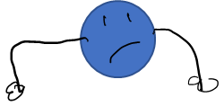
When suddenly he gets a call from the brain. “Help help I need energy to the frontal lobe we are going back to school and have to learn something”

Slide 4
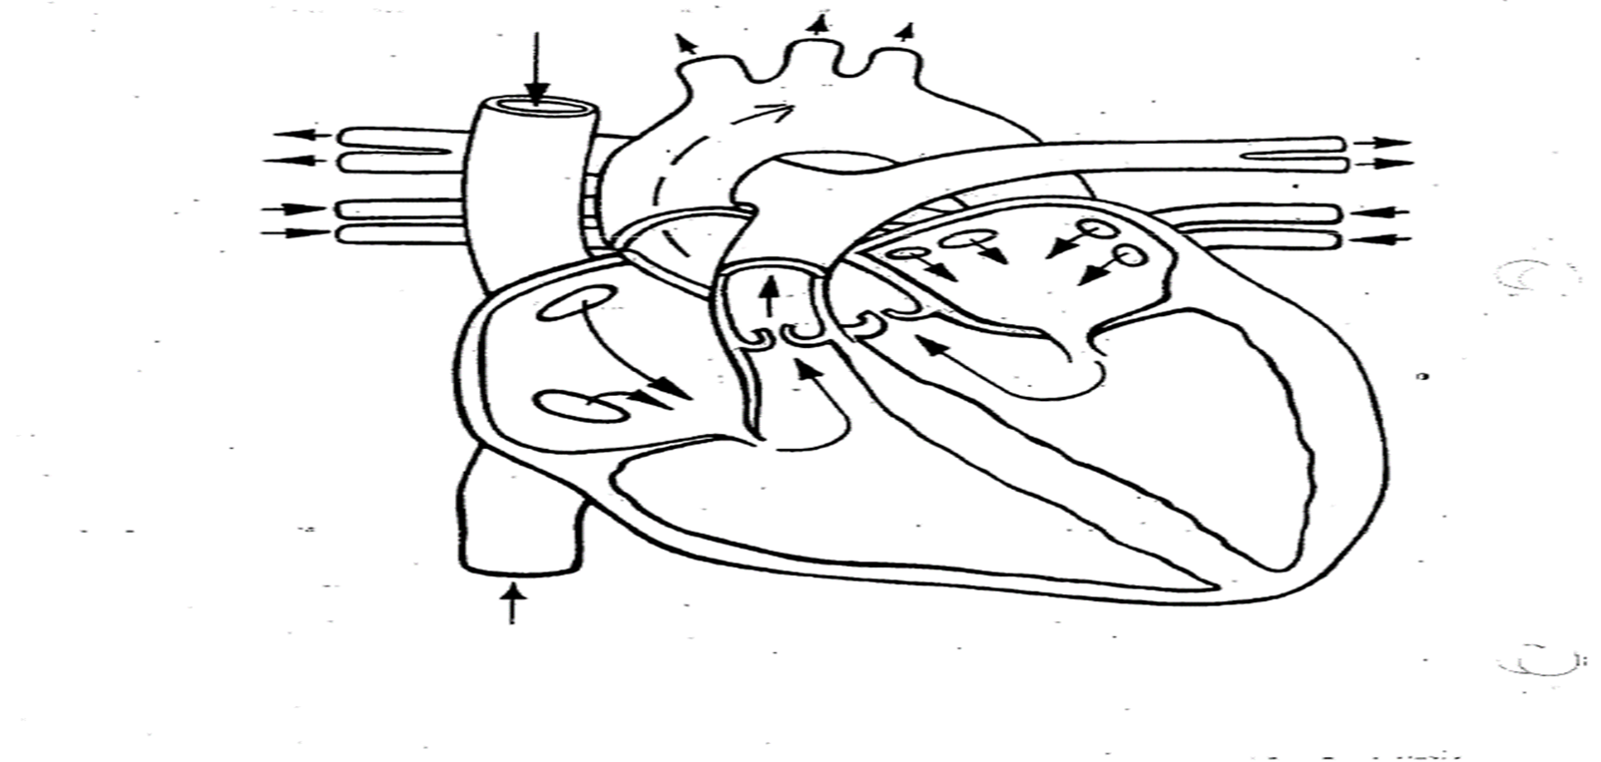
Arnie jumps onto his trusty plasma boat in the rt. ventricle and shoots off through the pulmonary artery to the lungs

Slide 5
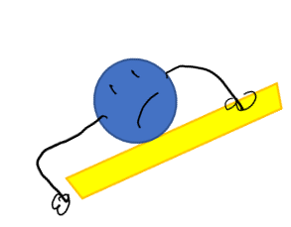
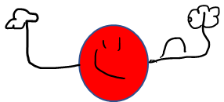
Arnie slowly gives up his CO₂to the alveoli and absorbs the oxygen for his mission

Slide 6
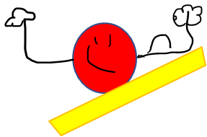
Arnie floats gently back to the left atrium through the pulmonary veins

Slide 7
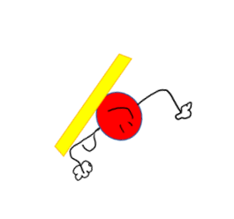
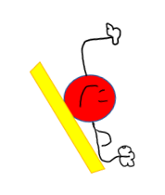
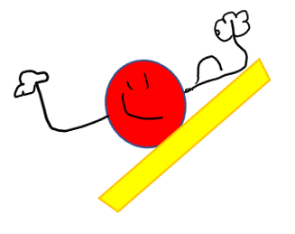
Arnie gets thrusted up the aortic arch and carotid artery with enough pressure to reach the brain

Slide 8
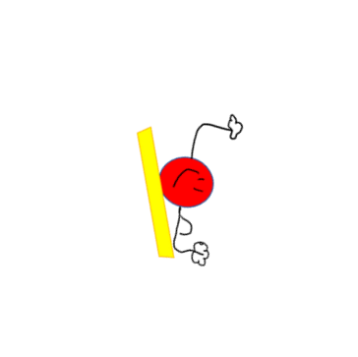
At last ! The frontal lobe! Arnie diffuses the O₂ into the brain and soaks up the CO₂

Slide 9
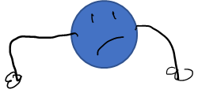
Exhausted, Arnie coasts down the jugular and into the superior Vena Cava for a rest in the old right atrium

Slide 10
Suddenly, “help help! We need O₂”

