Slide 1
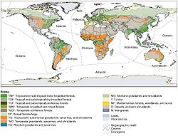
Biomes of the world
Giant global ecosystems based on
Temperature, rainfall, and dominant plant species

Slide 2
Importance of forest biomes
Forests represent a third of the earth's land.
The major attribute of the forest biome is its trees.
While humans and animals breathe in oxygen and exhale carbon dioxide, trees take in carbon dioxide and produce oxygen.
Deforestation represents a great threat to the future of the earth's atmosphere.
Once a tree is cut down, another should take its place, but there is still too large a number of trees being cut down as opposed to the number of trees being planted.

Slide 3
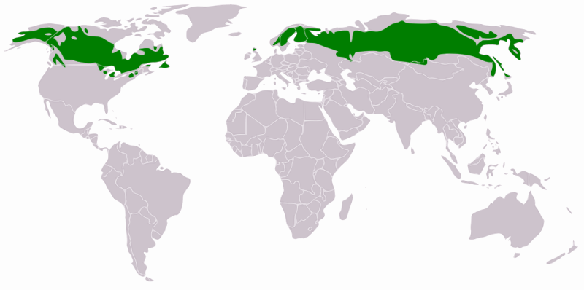
Taiga/Boreal Forest
Taiga, more barren northern areas of the Arctic tree line
Boreal forest more southerly part of the biome,

Slide 4
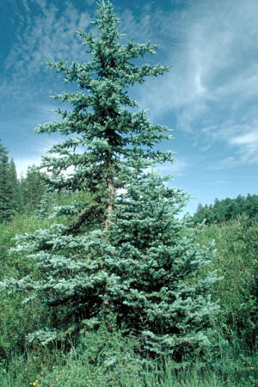
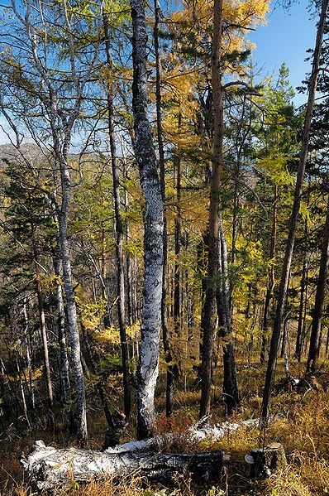
Temperature ranges from +30°C to -30°C
Precipitation: 20 cm per year to over 200 cm.
Much of the precipitation, of course, is in the form of snow.
Trees Mostly conifer
Black Spruce and Balsam Fir and some White Birch

Slide 5
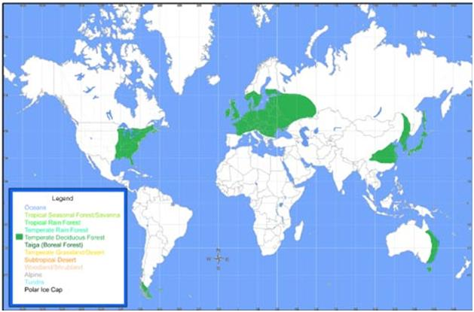
TEMPERATE DECIDUOUS FOREST BIOME
Map:

Slide 6
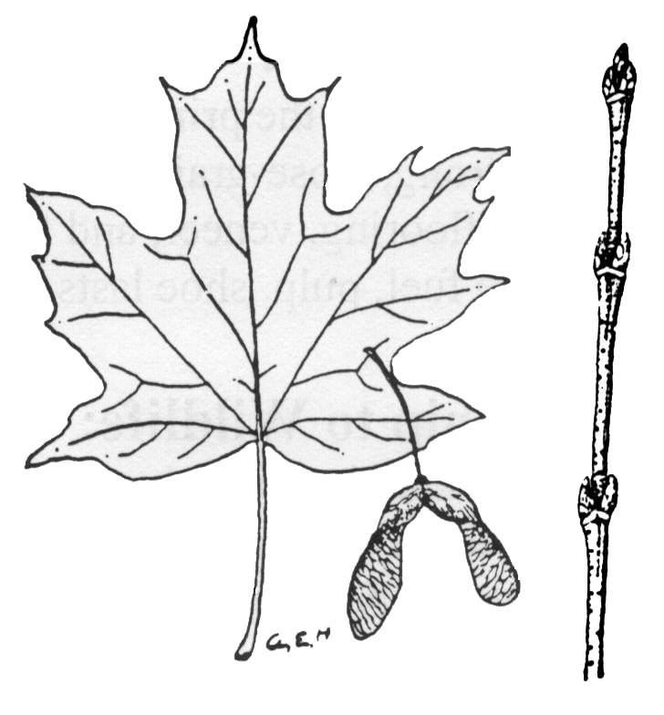
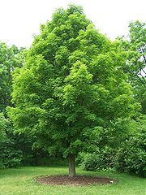
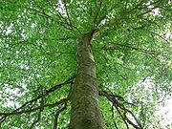
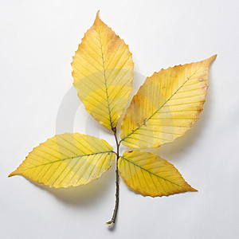
Temp.
Precipitation
Trees:
Sugar Maple
up to about 20° C down to freezing.
Precipitation ranges from around 50 cm yr⁻¹ in the colder regions to over 200 cm/yr.
north Maple forests
south Beech
American Beech

