Slide 1
Blood!

Slide 2
I. Make up of Blood
A type of connective tissue
Composed of a liquid (plasma), in which formed elements are suspended.
Blood is somewhat viscous (thick).
The viscosity of blood is due to the formed elements and the dissolved substances in the plasma

Slide 3
II. Blood Constituents
Plasma
Liquid component of blood
Has a yellowish colour
Makes up approx. 55% of total blood volume
Composed of:
90% water
10% dissolved substances
Nutrients
Hormones
Antibodies
Proteins
Function:
Transport dissolved substances to cells, and waste to excretory organs

Slide 4
Image of purified blood plasma

Slide 5
II. Blood Constituents
Formed Elements
Red Blood Cells
Scientific name is erythrocytes
Are the most numerous formed element in blood
Characteristics
Biconcave disk (disk with indents on both sides)
No nucleus
Contains hemoglobin
Heaviest of the formed elements
Function
To transport oxygen to the cells throughout the body.

Slide 6
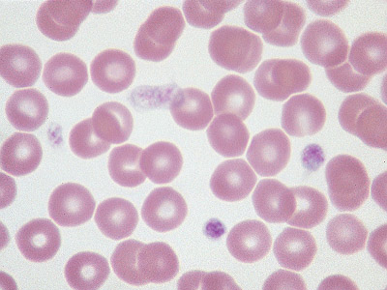
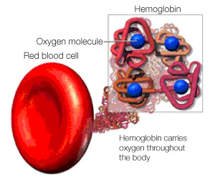
Image of RBCs under a microscope

Slide 7
II. Blood Constituents
White Blood Cells
Scientific name is leukocytes
Are the least numerous formed element in blood
Characteristics
Transparent cell
Irregularly shaped
Have a nucleus
Function
To defend against disease
To provide immunity

Slide 8
Artist drawing of the different types of WBC

Slide 9
II. Blood Constituents
Platelets
Scientific name is thrombocytes
Characteristics
Is a cell fragment
Has no nucleus
Smallest of the formed elements
Function
Help in coagulation (blood clotting)

Slide 11
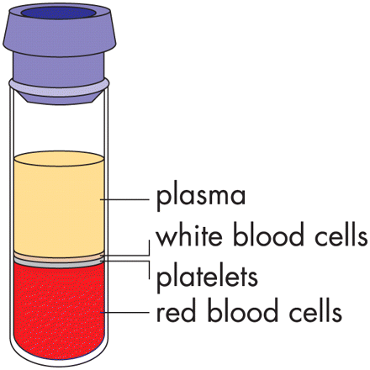
III. A sample of Centrifuged Blood
Approx. 55%
Formed Elements
Approx. 45%

Slide 12
IV. Blood Types
Determined by blood antigens called agglutinogens
The antigens are protein markers or bumps on the surface of the RBC
There are three main antigens
A
B
Rh factor (Rhesus factor) which determines positive/negative

Slide 13
Shape on red blood cell.
Antigen
Blood type
Antibodies in the plasma
can donate to types:
Can receive from Types:

Slide 14
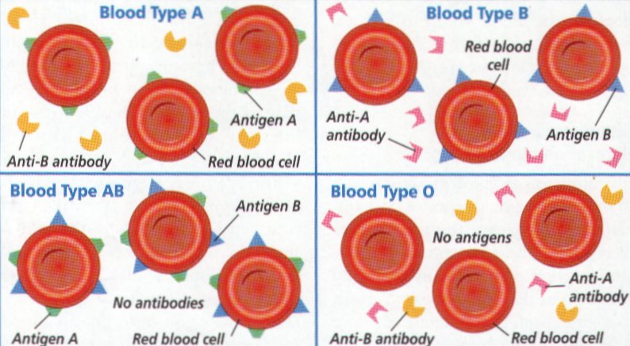
Antigens and Antibodies

Slide 15
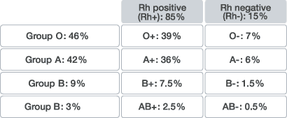
IV. Blood Types
B. Distribution in Quebec

Slide 16
Blood Typing
Place 2 drops of Sample 1 on each spot of the spot plate.
Add 2 drops antibody A to spot A, 2 drops of antiB to spot B and 2 drops of anti Rh to spot Rh.
When clumping happens, the RBC has the specific antigen.
Record your results.

Slide 17
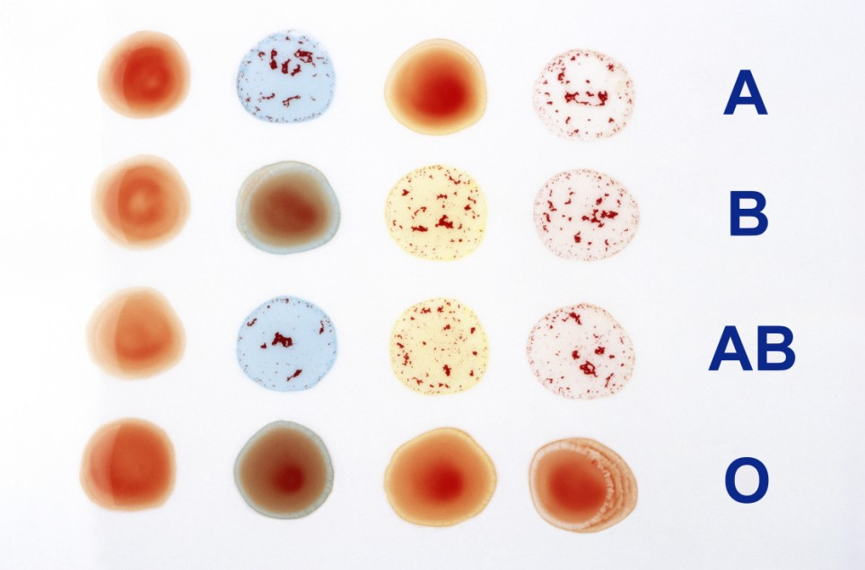
Test Results

Slide 18
V. Blood Transfusions
Def: The injection of blood into a person
Recipient -> RECEIVES (gets) blood
Donor -> DONATES (gives) blood
The recipient can not receive blood with antigens that are not already present on his/her own blood.
Blood will agglutinate (coagulate/clump) if it is mixed with blood having foreign antigens
I CANNOT RECEIVE WHAT I DO NOT HAVE!!!!

Slide 19
V. Blood Transfusions
Universal Donor
Is blood type O-
Can give to every blood type since it has no antigens on it
Universal Recipient
Is blood type AB+
Can get all blood types since it has all the antigens on it

Slide 20
V. Blood Transfusions
Blood Compatibility Chart
 |  | Donor Blood Type
 |  | O- | O+ | A- | A+ | B- | B+ | AB- | AB+
Recipient Blood Type | AB+ | ✓ | ✓ | ✓ | ✓ | ✓ | ✓ | ✓ | ✓
 | AB- | ✓ |  | ✓ |  | ✓ |  | ✓
 | B+ | ✓ | ✓ |  |  | ✓ | ✓
 | B- | ✓ |  |  |  | ✓
 | A+ | ✓ | ✓ | ✓ | ✓
 | A- | ✓ |  | ✓
 | O+ | ✓ | ✓
 | O- | ✓

Slide 21
Transfusions
O
A
B
AB
Rh
_
+

Slide 22
V. Blood Transfusions
Blood Transfusion – Online Game

Slide 23
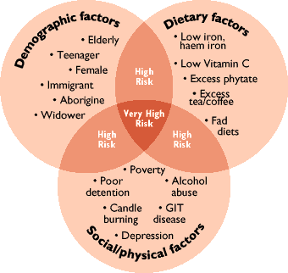
VI. Blood disorders
Anaemia
Not enough healthy RBC
Low oxygen levels

Slide 24
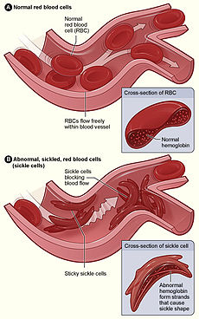
VI. Blood disorders
B. Sickle Cell Anaemia
Genetic disorder of RBC
Cells form a sickle (crescent) instead of a biconcave disk
Low oxygen transport
Forms clots and blocks capillaries

Slide 25
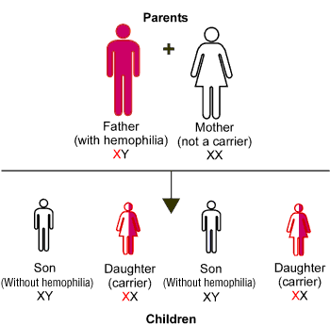
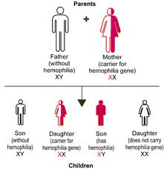
VI. Blood disorders
C. Haemophilia
Blood clotting disorder
Inherited disease – linked to X chromosome

Slide 26
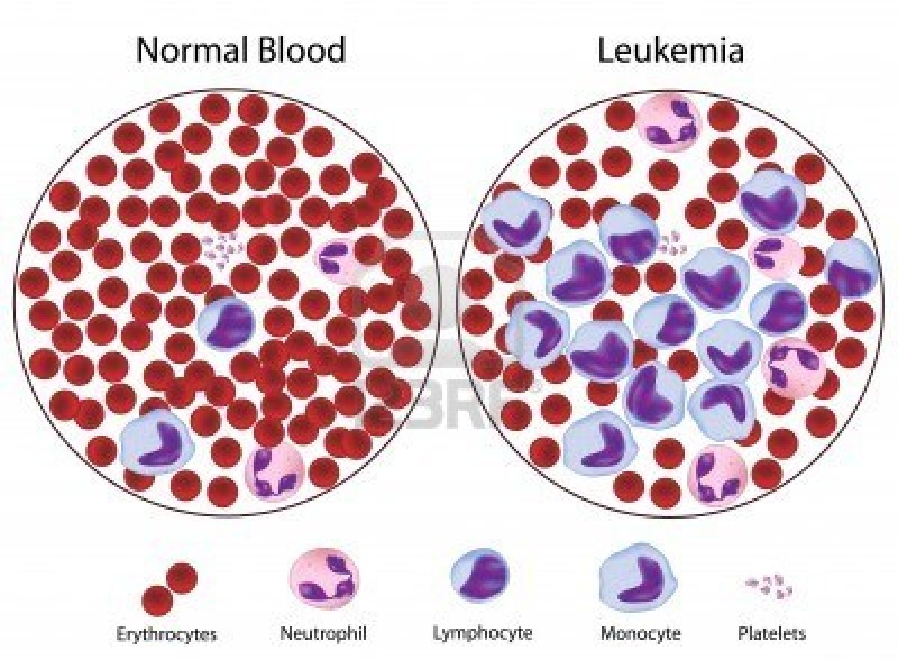
VI. Blood disorders
D. Leukaemia
Cancer of WBC

Slide 27
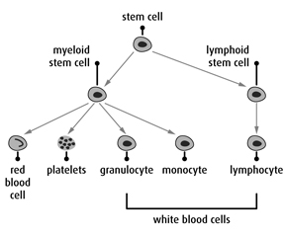
VI. Blood disorders
D. Leukaemia

Slide 28
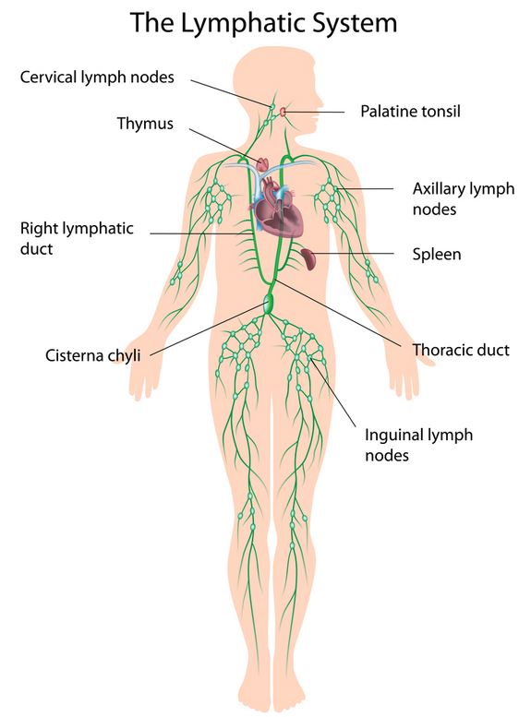
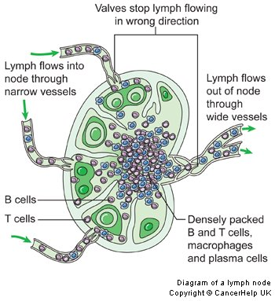
V. Lymphatic System
Video: Lymphatic system.mov
Video: Lymph nodes animation

Slide 29
Lymph capillary system

Slide 30
Lymph Capillary Please draw

Slide 31
Lymph vessels with valves

Slide 32
Lymph vessels with valves please draw

Slide 33
Lymph Nodes

Slide 35
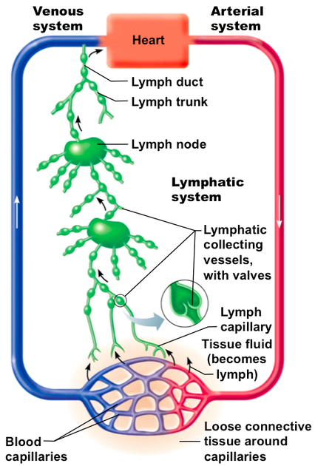
Lymphatic system
Open system returns to the venous system at sub clavial vein near superior Vena cava

Slide 36
Circulatory vs Lymphatic Systems
Topic | Circulatory System | Lymphatic System
What is the function of the system? | Moves wastes Collects and distributes oxygen, nutrients and hormones. Regulates temperature. | Collects and transports waste products generated by the tissues into the circulatory system.

Slide 37
Circulatory vs Lymphatic Systems
Topic | Circulatory System | Lymphatic System
How does the fluid flow around the system? | Flows in a closed continuous loop through arteries, capillaries & veins. Blood is pumped by the heart. Muscles in veins assist in movement. Valves prevent backflow in veins | Flows in an open circuit from tissues into lymphatic vessels to be deposited into vena cava. Lymph is not pumped. Deep breathing and muscles aid movement. Valves prevent backflow in larger lymphatic vessels.

Slide 38
Circulatory vs Lymphatic Systems
Topic | Circulatory System | Lymphatic System
What is the fluid made of? | Plasma White blood cells Red blood cells Platelets Nutrients Hormones Some wastes Oxygen | Lymph White blood cells Many wastes Carbon dioxide

Slide 39
Circulatory vs Lymphatic Systems
Topic | Circulatory System | Lymphatic System
How is the fluid filtered? | Blood is filtered by the excretory system. Nephrons in the kidneys remove wastes and excess water as urine. Carbon dioxide is removed in the lungs. | Lymph nodes remove some fluid and debris. White blood cells clustered in these nodes also kill pathogens and some cancer cells.

