Slide 1
Cells
Basic unit of life

Slide 2
Cells
All living things are composed of at least one cell.
Bacteria, for example, are composed of one cell, whereas humans are composed of approximately 60 trillion cells.
All cells need nutrition, produce energy, exchange information, multiply and eventually die.
Cells have different shapes and functions. For example, a blood cell has a different shape and function than a bone cell.

Slide 3
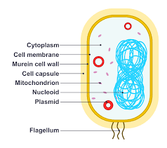
Bacterial cell

Slide 4
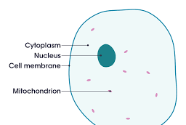
Animal cell

Slide 5
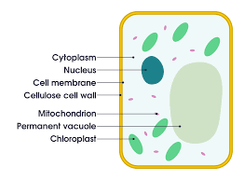
Plant cell

Slide 6
Characteristics of cells
Most cells are very small and are only visible using a microscope.
The main components of an animal cell are: cell membrane, cytoplasm, nucleus, nuclear membrane, mitochondria.
The main components of a plant cell are: cell wall, cell membrane, cytoplasm, nucleus, nuclear membrane, mitochondria, chloroplast.
The cell membrane is an envelope that surrounds the cell. It controls what enters and leaves the cell.
The cytoplasm is a jelly-like substance which contains organelles (structures inside the cell). Substances like oxygen, water, wastes, nutrients circulate in the cytoplasm.

Slide 7
Characteristics of cells
The nucleus controls all activities of the cell and contains genetic material. We consider it the “brain” of the cell.
The nuclear membrane surrounds the nucleus and it also controls the exchanges between the nucleus and the cytoplasm.
The mitochondria produces energy through a process called cellular respiration.
The vacuole stores water, nutrients and waste.

Slide 8
Organelles exclusive to plant cells
The cell wall is a rigid envelop that surrounds the cell membrane. It makes the plant rigid and gives the cell a geometric shape.
The chloroplast contain green pigments called chlorophyll. It is the site of photosynthesis (process where the cell makes and stores sugar which nourishes the plant).

