Slide 1
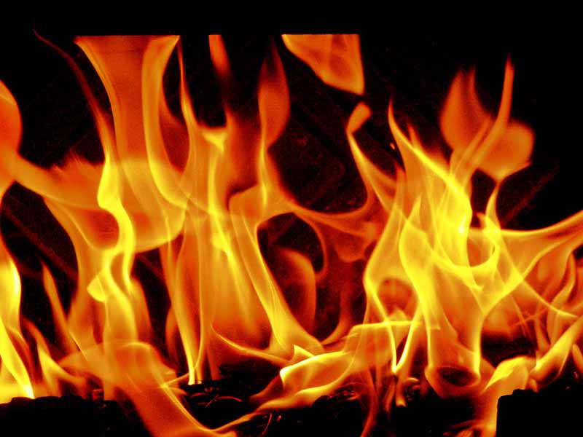
Cellular Respiration
Or
Burning food to get energy

Slide 2


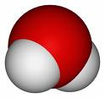

Reactants → Products
Glucose + Oxygen → Carbon dioxide + Water
C6H12O6 + O2 → CO2 + H2O
+ → +

Slide 3



Plants and animals need Energy to
Move and keep warm

Slide 4
Plants and animals need Energy to reproduce and grow

Slide 5
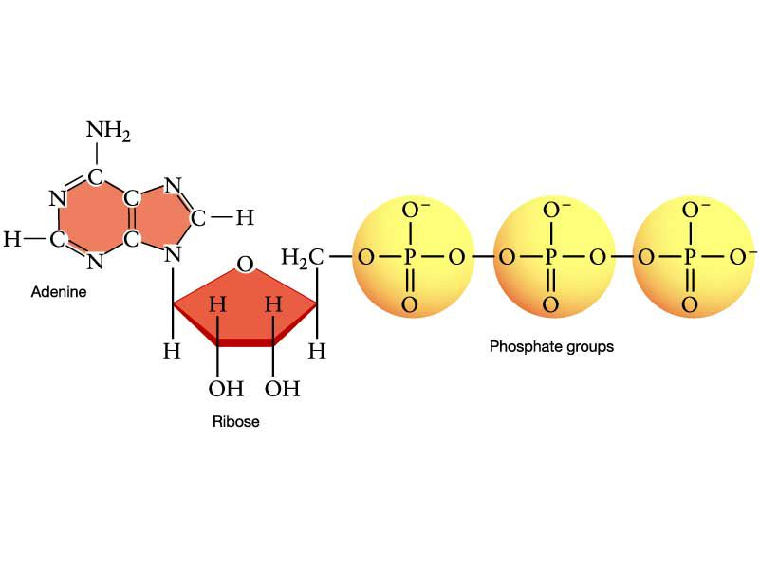
Plants and animals need Energy in the form of ATP for all their body’s chemical reactions this is called metabolism
Adenosine triphosphate

Slide 6
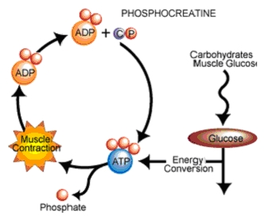
1 Phosphate breaks off the ATP and releases energy
Respiration sticks the phosphate back on and recharges the molecule like a battery
Respiration
Growth
Warmth
Muscle energy
Active transport

Slide 7
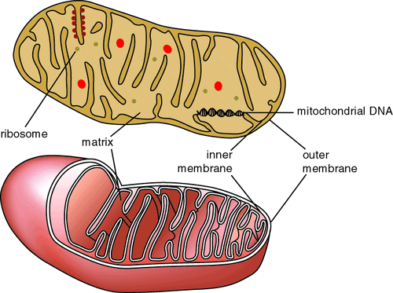
Respiration is Burning glucose to make ATP
It happens in the Mitochondria The powerhouse of the cell.

Slide 8
Mitochondria
Have a double membrane
Have their own DNA & were once an independent organisms
They break down glucose C6H12O6 in the Matrix (Spaces)
This part Makes the CO2
They recharge ATP on the Inner folds (Christae)
This part makes the H2O

Slide 9
Similarities and differences between
Respiration
Photosynthesis
Occurs in Mitochondria, Organelles with double membranes.
Breaks glucose apart.
Makes CO2.
Makes Water
Releases energy from C-C bonds
Gives energy to body
Occurs in Chloroplasts, organelles with double membranes.
Puts glucose together
Needs CO2
Needs water
Takes energy from sun
Stores energy in C-C bonds

Slide 10
Are We Getting the Pattern Here?
Respiration
Glucose + Oxygen → Carbon dioxide + Water
Photosynthesis
Carbon Dioxide + Water →Glucose + Oxygen
The inputs of one are the output of the other.

Slide 11
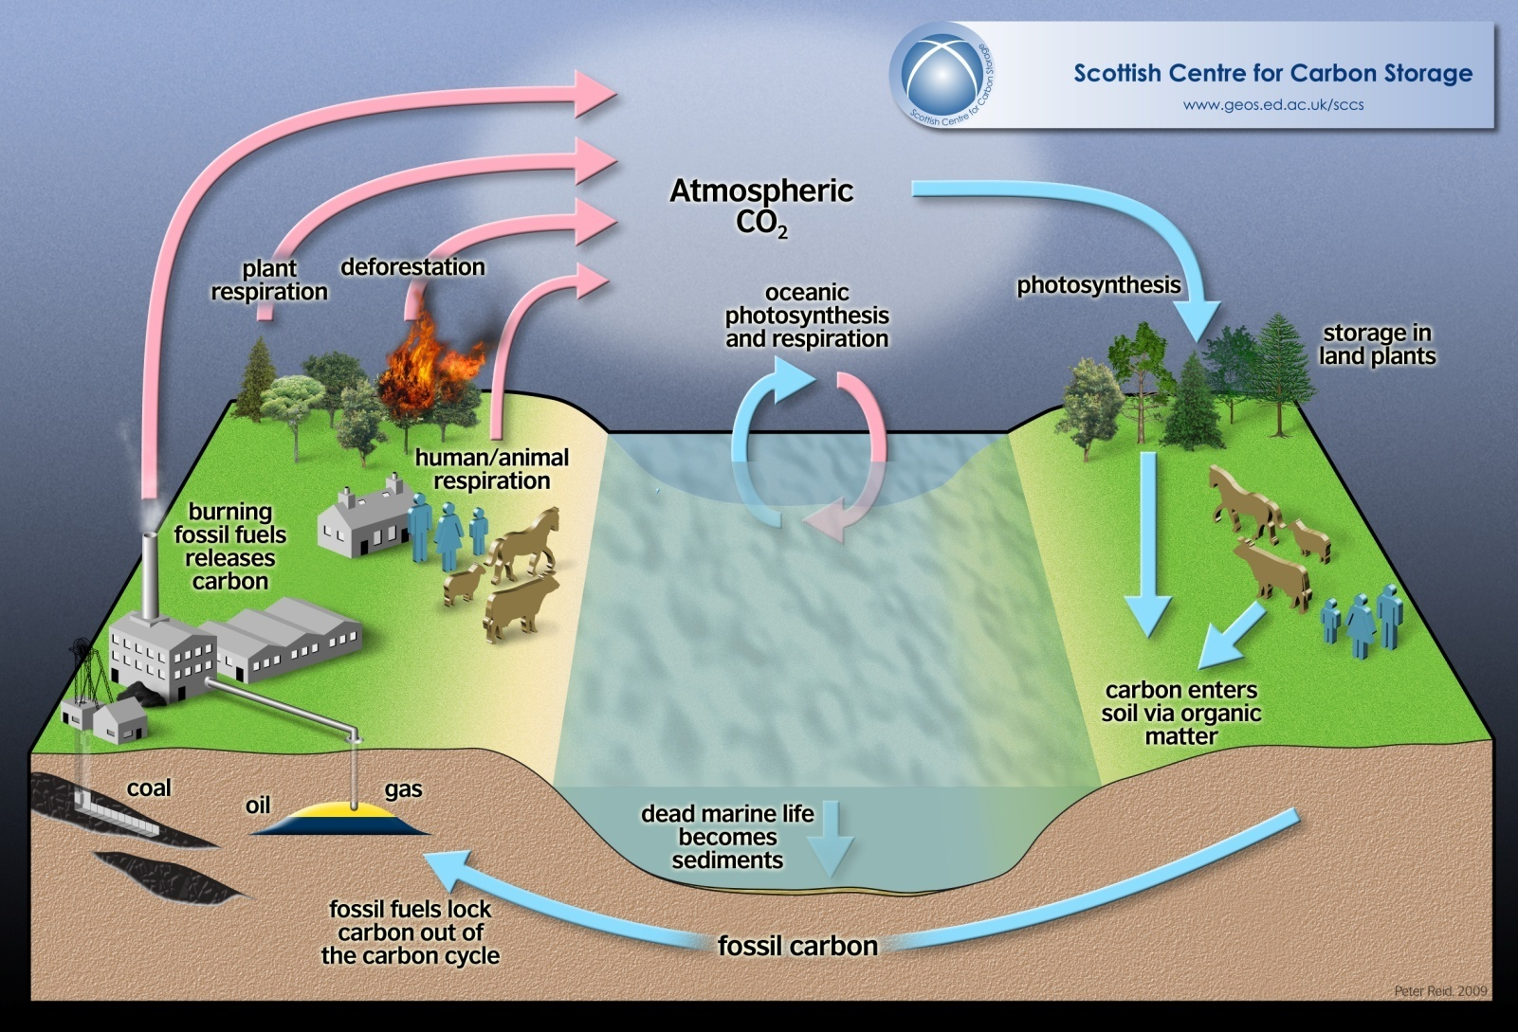
Together they are called the Carbon cycle

