Slide 1
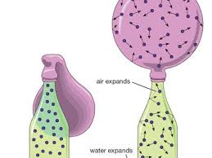
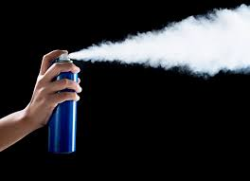
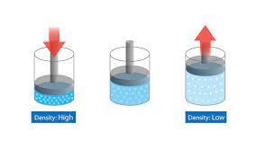
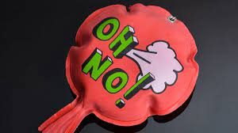
Compressible fluids
You’ve got gasssssssssss

Slide 2
Air is a compressible fluid
Air is a mixture of gases.
Gases flow
Gases can change their volume
Gases are compressible they can be squeezed

Slide 3
Air pressure
Small space High Pressure
Big space low pressure
Few collisions
Lot’s of collisions

Slide 4
Air always flows from High pressure to low pressure

Slide 5
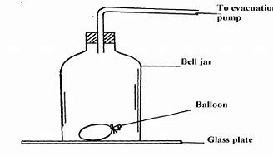
Bell Jar
The bell jar is sealed
We can pump out the air particles
This lowers the pressure inside the jar
We can open a valve and let in the air particles
This raises the pressure inside the jar.

Slide 6
demo
What will happen to the balloon if we suck out the air?
Hypothesis:
Experiment:
Explanation:
What will happen if we let the air back in?
Hypothesis:
Experiment:
Explanation:

Slide 7
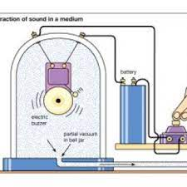
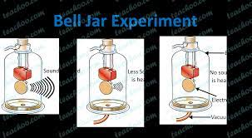
What will happen to the bell when we suck out the air?
Hypothesis:
Experiment:
Explanation:

Slide 8
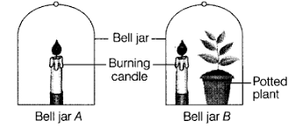
What will happen to a candle in the bell Jar?
Hypothesis:
Experiment:
Explanation:

