Slide 1
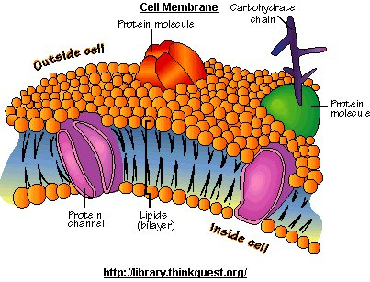
Diffusion and osmosis
How particles move back and forth across the membrane
The door way to adventure

Slide 2
Particle model
Particles are always moving.
This is called Kinetic energy.
Solutions are made of 2 kinds of
particles.
Solute particles like salt or sugar
things that your cell needs
Solvent particles usually water
that dissolve the salt
Did you know the cytoplasm
in your cell is 98% water?

Slide 3
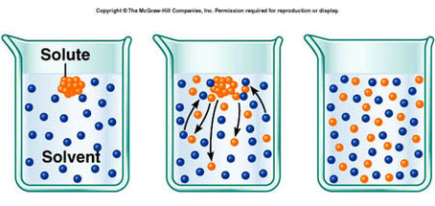
Diffusion
These particles are always moving like crazy and bumping into each other
This makes them spread out to an area that is less crowed.
Particles move from a high concentration to a Low concentration.

Slide 4
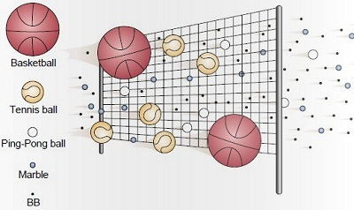
It works through a membrane too. Membranes have holes in them. Can you spot the problem in the 2nd picture?

Slide 5
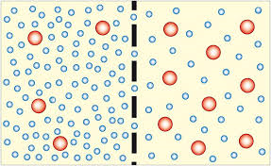
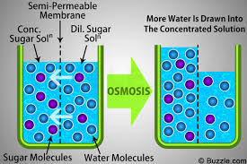
Osmosis… enter water
Water particles move too.
If a solute particle is too big then it can’t get through the holes in the membrane.
The water (solvent particles) rush through the membrane to dilute it.

Slide 6
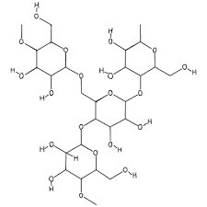
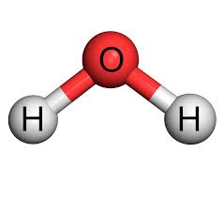
Potato cells are full of starch and water
Which particle is going to move across the membrane?
Starch water

Slide 7
Potato osmosis
Watch this
We are going to do this lab with three holes in 1 potato.

Slide 8
To sum up
Diffusion is the movement of solute particles from an area of high concentration to low concentration
Hi
Lo
Osmosis is the movement of water particles (solvent) from an area of a high concentration of water to a low concentration of water.
Hi water
Lo water

Slide 9
Osmosis goes in the opposite direction as diffusion
Hi conc. Of particles and low conc. Of water
Low conc. Of particles and hi concentration of water
equilibrium
osmosis
diffusion
Semi permeable membrane

