Slide 1
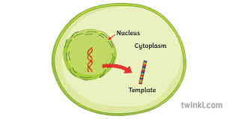
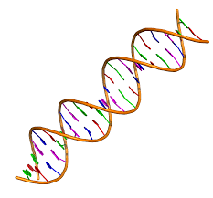
DNA and the Nucleus

Slide 2
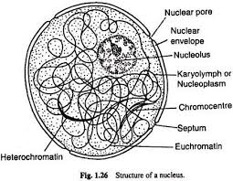
All the DNA is kept safely inside the Nucleus

Slide 3
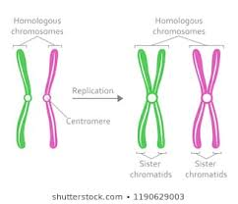
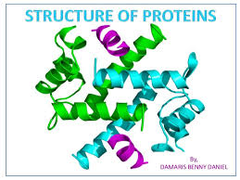
DNA can do 2 things
It can copy itself
It can make proteins

Slide 4
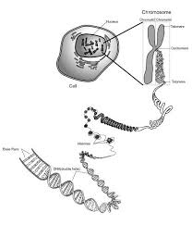
When it is time to divide the DNA copies itself and coils up into a chromosome

Slide 5
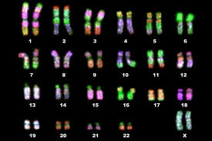
Each of theses coiled up DNA pieces are called Chromosomes
We have 46 (23 pairs……1 from your dad and 1 from your mom)

Slide 6
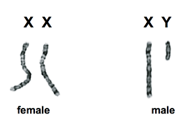
Pair #23 tells you if you are a girl or a boy

Slide 7
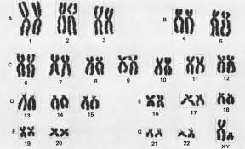
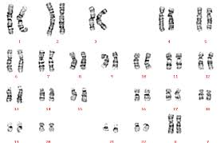
Which karyotype is a boy and which is a girl?

Slide 8
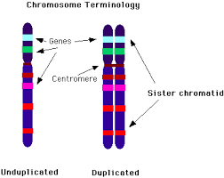
Do you notice all the stripes on the chromosomes?
Each stripe is a short piece of DNA that makes a protein.
1 gene = 1 protein
Each chromosome makes lots of genes.
Your genes give you traits.
This tells you what you look like.

Slide 9
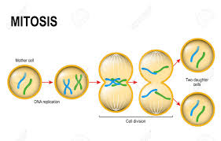
Mitosis
When you grow taller you have to make new cells.
When you heal a cut you have to make new cells.
Mother cell→duplicates DNA→DNA splits→ 2 daughter cells identical to mother cell

Slide 10
What would happen if you fused 2 normal cells together
you die
46
46
92

Slide 11
Meiosis is a special cell division that makes eggs and sperm.
Your eggs and sperm have 23 chromosomes. Half the normal number.
Ta dah! You live
23
23
46

Slide 12
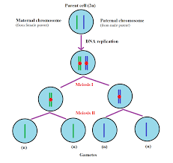
Meiosis
1 mother cell with 2 chromosomes
4 cells with 1 chromosome each

Slide 13
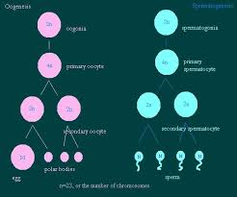
Ever wonder why eggs are bigger than sperm?
During meiosis
The cell divides
Unevenly.
The egg hogs all the cytoplasm (and the other 3 cells die)the body.
That’s why the egg is the largest cell
It’s as wide as a human hair

Slide 14
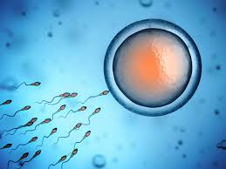
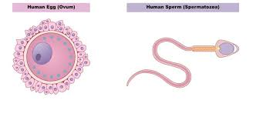
Gametes
Gametes are special cells that have ½ the number of chromosomes.
They are eggs and sperm.

Slide 15
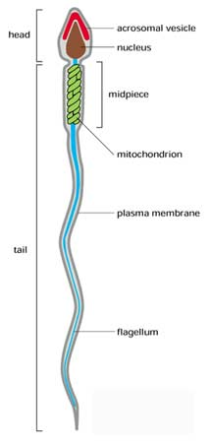
Structure and function of sperm
The head has 2 parts:
The acrosome protects the nucleus and pushes
The cementum of the egg.
The nucleus contains ½ the dad’s chromosomes
and some enzymes to help break through.
The mid section
is full of mitochondria to provide the energy
The Tail
Is the cell membrane and inside there is a
Flagellum for swimming

Slide 16
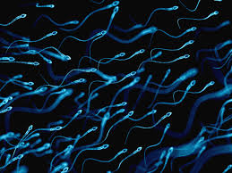
This is what you’ll see under the microscope

Slide 17
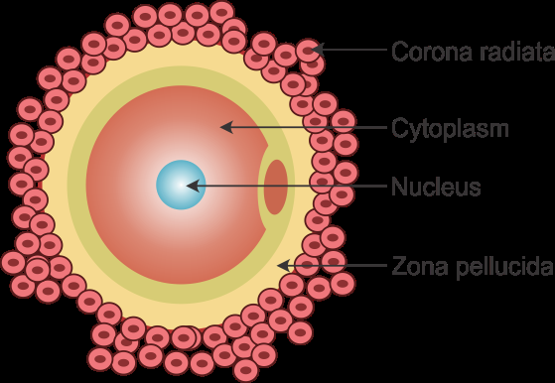
Structure and function of egg
Ring of follicle cells:
Protect egg and make
a cement layer the sperm
must drill through.
Cytoplasm
All the machinery
to make a new organism
Nucleus
½ the mother’s
chromosomes
Rring of follicle cells
Cytoplasm
Nucleus
Zona Pellucida

Slide 18
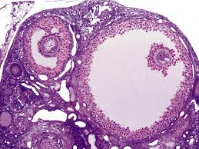
ovary
Ovary
Follicle
Ovum (egg)

