Slide 1
Fertilization and reproduction
Egg meets sperm
At the right time
In the right place

Slide 2
Meiosis is the opposite of fertilization

Slide 3
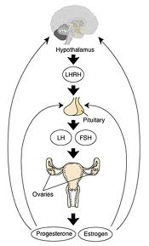
Hormone cycle and ovulation
Your brain is your
biggest sex organ
The pituitary makes
2 hormones: FSH and LH
Follicle stimulating hormone
Luteinizing hormone
They stimulate:
egg and sperm production
male and female hormones

Slide 4
Estrogen, progesterone and testosterone
Female hormones
Male hormones
Estrogen
Progesterone
1⁰ sexual characteristics
^{Ovaries mature}
^{Menstrual cycle begins}
2⁰ sexual characteristics
Breasts, hips, pubic hair, psychological changes.
Testosterone
1⁰ sexual characteristics
^{Testicles mature}
^{Sperm production begins}
2⁰ sexual characteristics
Facial hair, deep voice, bone density and muscle growth, pubic hair, psychological changes.

Slide 5
Menstrual cycle

Slide 6
Hormone switches
Pituitary senses the falling progesterone and estrogen in the blood and switches on LH and FSH
FSH tell the ovaries to produce Estrogen
The follicle ripens with the egg
LH, FSH, Estrogen peak.... Ovulation occurs
Follicle becomes a corpus luteum and makes progesterone.
Progesterone peaks corpus luteum shrivels, progesterone levels fall and we start all over again.

Slide 8
Timing is everything.
The egg ovulates and lives for about 24 hours.
Once ejaculated the sperm lives for 3 -5 days.
For fertilization to occur there is a window of opportunity
4 days before ovulation and one day after ovulation.

Slide 9
Fertilization: once the egg and sperm nuclei fuse. The egg changes chemically and no other sperm can get in

Slide 10
Stages of pregnancy
Zygote
Fertilied egg floats in the fallopian tubes and divides until it becomes a ball of 100 cells and embeds in the uterine wall. (3-5 days)
Embryo
Once embedded in the uterus it is called the embryo
Cells continue to divide and start to differentiate
Until all the organs are formed. (Up to 8 weeks of pregnancy)
Fetus
The cell divisions continue and organs develop until about 40 weeks when birth occurs

Slide 11
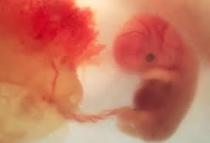
Attachment
The fetus attaches to the mother
with an umbilical cord.
This is connected to a special organ
called the placenta.
The placenta allows the mother
and baby’s blood to get really close
and exchange oxygen and nutrients
but the two bloods never mix.
This protects both the mother and baby
The belly button is the scar where the umbilical cord was attached

Slide 12
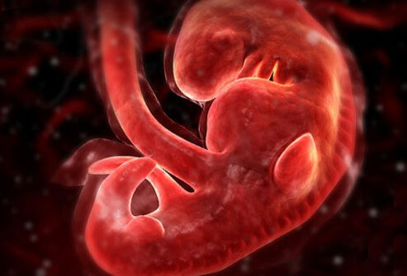
Development
At 4 weeks
The fetus is attached and has
A head, chest and abdomen
Limb buds and a tail
It’s about the size of an apple seed

Slide 13
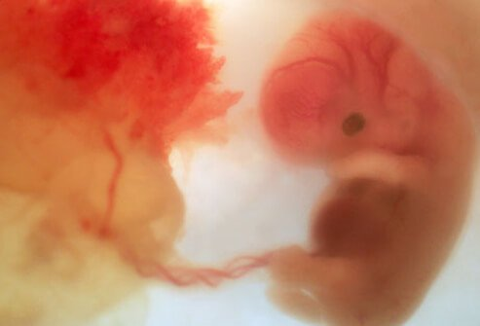
At 8 weeks
You can see facial features
Fingers and toes
It is 1.1 cm
which is the size of a
pumpkin seed

Slide 14
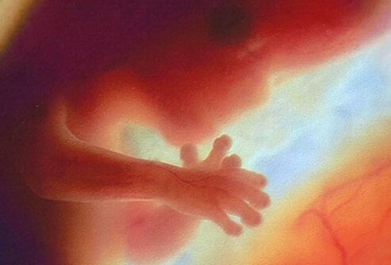
12 weeks
Now the fetus has a heart beat
It can wiggle its fingers
It’s sexual organs are developing
It’s 4.4cm or the size of a grape

Slide 15
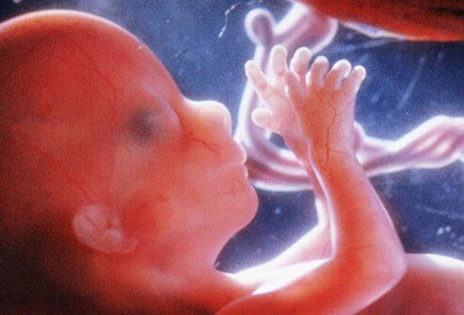
16 weeks
At this stage the fetus
looks like a baby
And it even has finger prints.
Now it’s about 10 cm
Which is the size of an avocado
Mom starts having a baby bump.

Slide 16
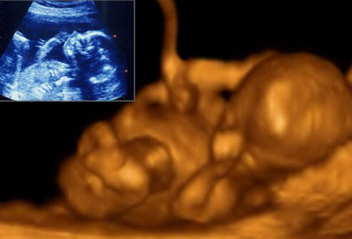
At 20 weeks
It can start sucking its thumb
Kicking its feet, yawn
This is called “quickening”
Now the fetus is 13cm
The size of a grapefruit

Slide 17
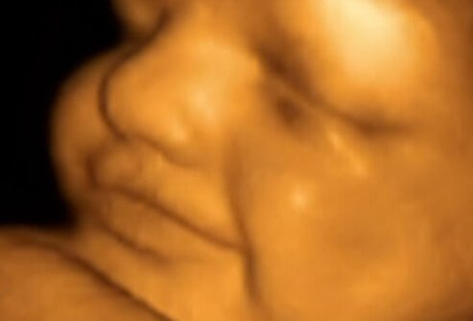
At 24 weeks
The inner ear starts to develop
The baby can hear
It even gets the hiccups
Now it’s a little more than ½ a kilo
The size of a block of butter.

Slide 18
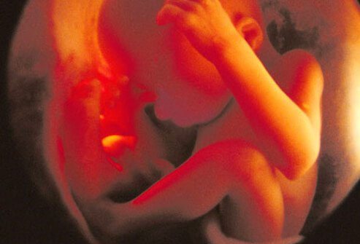
At 28weeks
The baby has a good chance
to survive if born prematurely
It’s about a kilo
The size of a small squash

Slide 19
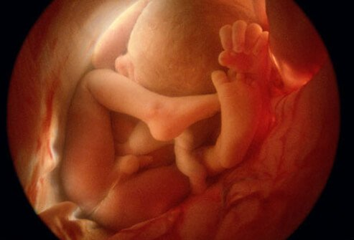
36 weeks
36-40 cm long
3 kilos ready to be born
Anytime between 36-42 weeks

Slide 20
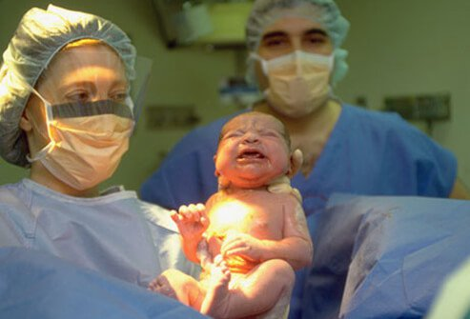
40 weeks
Tah dah

Slide 21
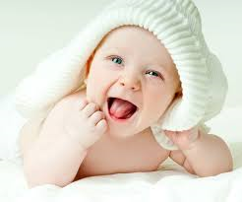
The development continues…
Infancy 0-2 years
is characterized by :
Rapid brain development
Fast growth
Development of immune system
Walking by 1 yr, talking by 2 yrs.

Slide 22
Early childhood 2-6 years
Is characterized by:
Rapid growth
Development of fine motor skills (colouring)
Play (learning to socialize with peers)

Slide 23
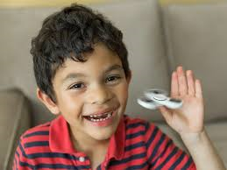
Childhood ages 6-10
Is characterized by:
Slower growth rate
Increased strength and coordination.
(kids learn to jump-rope by 5 and ride a bike by 7)

Slide 24
Adolescence 10- 18
Adolescence is from the Latin word that means “to grow up”
It wasn’t used as a life stage until 1904. you were considered an adult at 13.
Now we recognize it as an important stage of development.
It is characterized by:
Puberty: the development of reproductive organs. 1⁰ and 2⁰ sexual characteristics.
Identity: a time of discovering who you are.
End of growth.
Girls last growth spurt 12-14. Boys last growth spurt 14-18
Continued brain development
for girls until 21, for boys until 26.

Slide 25
Adulthood 18-70
Longest stage of human development
Maturity
Productive and engage in society
Reproduce and have families
Reproduction for women stops at menopause around the age of 50.
Men can reproduce until they die.

Slide 26
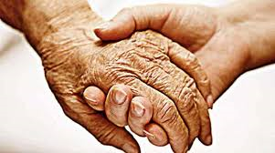
Old age 70 -………..
For men it begins at 67 for women it begins at 70 .
This is a time when due to the wear and tear of life your organs start to deteriorate. You have a reduction of activities.
You get cataracts in your eyes or you need a hearing aid, your knees don’t work and you need a cane.
Some people live a very healthy old age.
The older you live, the longer your life expectancy.
Right now in Canada the average is 79 for men and 83 for women.
Financial advisers will tell you to plan to live until you are 99.

Slide 27
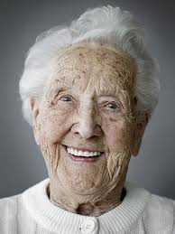
Match the life stage to each picture
old age
infant
childhood
adolescense
Early childhood
infant
Old age
adult
Early childhood
Old age
adult
adult
childhood
adolescense
Old age
Early childhood
adult
adolescense
infant
adult
adult
adult
adolescense
k.______________ l.___________ m. ___________ n.___________ o.________
p. ____________ q. ____________ r.________________
s. Camilla Gabello t.Chance the Rapper u. Alexis Lefreniere v. Ariana Grande
_______________ _________________ _______________ _____________________

Slide 28
Contraception how to protect yourself from infections how to choose when to get pregnant or avoid it completely
Knowing the female hormone cycle helps to make contraceptive treatments. They are grouped into 4 catagories:
Hormonal treatments
(prevent ovulation by tricking the body into thinking it is pregnant)
Barrier methods: (Block egg from meeting sperm)
Sperm toxins ( kill the sperm before it meets the egg)
Permanent (surgery that blocks the tubes that carry the sperm and egg so they can’t get out)
All catagories work well only if they are used properly
All methods have disadvantages with them too.
During your life time you may use several different methods.

Slide 29
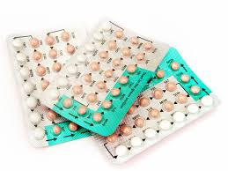
Hormonal methods
The pill: Synthetic hormones (estrogen and progesterone)
Pros
Prevent ovulation by tricking body into thinking it is pregnant.
99.5% effective must be taken at the same time every day
Allows for more spontaneity
Regulate menstrual flow and cramps
Cons
Requires a prescription
Can cause blood clots

Slide 30
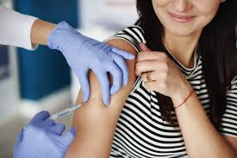
Contraceptive injection: 99.7% effective
synthetic hormones injected into the muscle once every 3 months.
Pros:
Prevents ovulation for 3 months
Does not allow the uterine lining to accept a fertilized egg.
Cons:
Requires a prescription
Does not require daily action
Takes up to 9 months to wear off if you want to get pregnant.

Slide 31
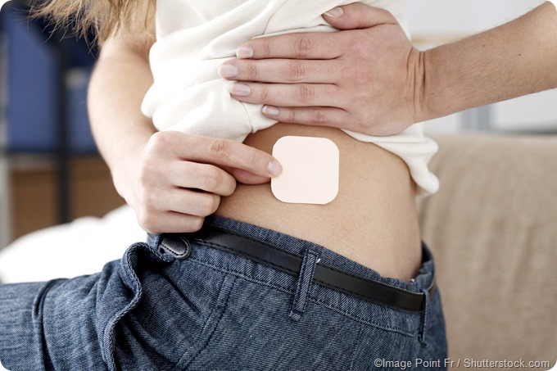
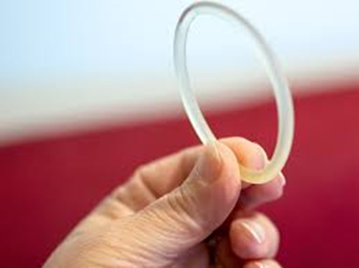
Contraceptive patch or ring
Patch: 99% stick a patch on your arm every month
Pros:
similar to the pill prevents ovulation
Cons:
If patch falls off you must use another method til the end of the month.
Ring: 99% flexible ring containing hormones is placed around cervix.
Pros:
similar to pill
Cons : must be replaced every month. Three weeks on 1 week off.
Requires prescription
Some women can feel it.

Slide 32
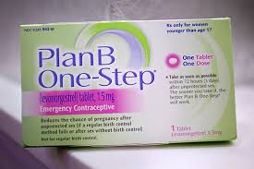
Morning after pill
Use after unprotected sex.
95% effective up to 12 hours
60% effective after 5 days
Pros: In case of emergency only very high dose of hormones.
Cons: not very effective
Requires perscription

Slide 33
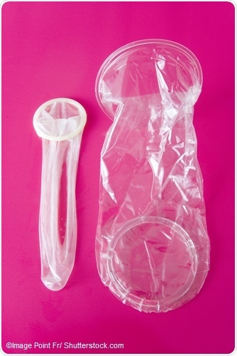
Barrier methods Male and Female condoms
Condoms 86% effective: often used with a spermicide 99%effective
Poly urethane or latex sheath that covers an erect penis or inserts into the vagina
Pros;
Easily available male condom is cheaper than female condom.
Prevents Infections as well as pregnancy
Doesn’t affect hormone cycle
Cons:
Must be used properly can be difficult to insert.
May break
Requires attention immediately before intercourse.

Slide 34
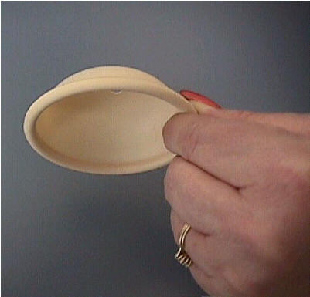
Cervical cap or diaphragm
A small latex dome that covers the cervix. Can be inserted up to 2 hours before intercourse. 80-91% effective less if you have had children.
Pros:
lasts longer than condoms
Does not affect menstrual cycle
Does not require action immediately before intercourse
Cons:
Must be measured and fitted by a doctor
Insertion is difficult

Slide 35
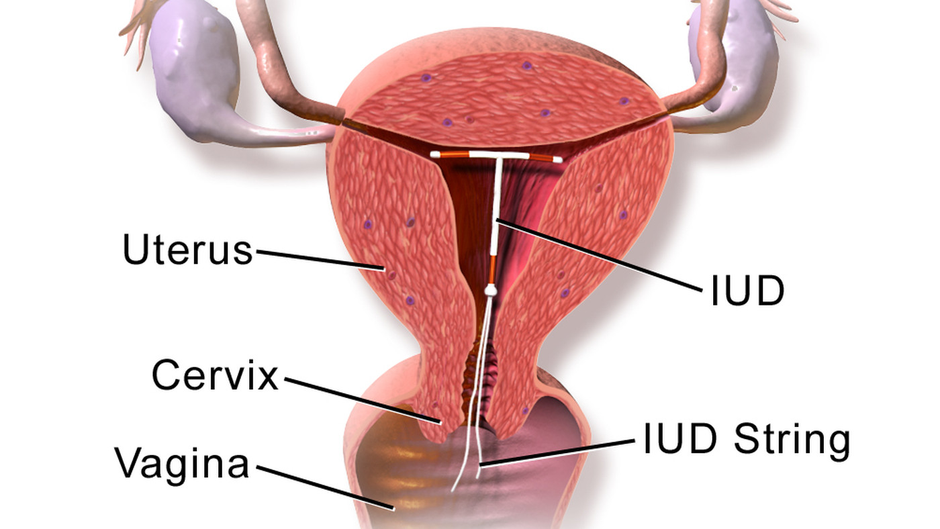
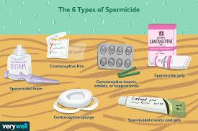
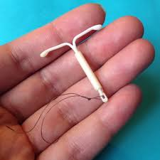
Toxic methods
Spermicides 74%-94% effective
Placed in the vagina or on the condom just before intercourse. Kills sperm
This works best when used in conjunction with the barrier methods.
IUD or intra uterine device. 94-99% effective
Covered in copper. Shaped like a “T” and placed in the uterus
The copper kills the sperm and the “T” prevents the egg from implanting.
Pros:
reliable long term method 3-5 years
Often used after you have had children
Cons:
requires a prescription and doctors appointment

Slide 36
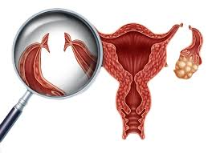
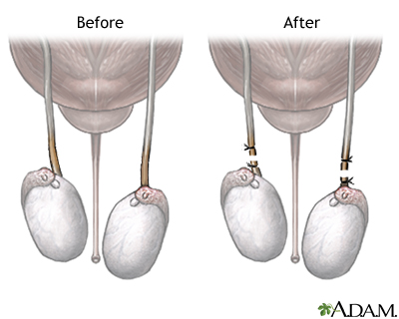
Permanent methods
When you are sure you no longer want to have any children.
Women: tubal ligation. Major internal surgery
The fallopian tubes are cut and the ends sealed off. Egg can no longer meet sperm
Ovulation still occurs with normal hormone cycle
Men: Vasectomy. Minor day surgery
The vas deferens are cut and the ends sealed. Sperm can’t get out.
Erections and ejaculations are normal they just contain semen with no sperm.

Slide 37
STBBI’s sexually transmitted and blood born Infections
These infections are spread by having unprotected sex, genital contact, and sharing fluids (use a condom!!!)
and with contact with body fluids like blood (Never share syringes for drugs or needles for tattoos or ear piercings.)
These infections can be very slow in growing and even asymptomatic. This means you can have them and not know it.
Some are caused by bacteria. These can be treated with antibiotics. Many of these diseases are rapidly becoming antibiotic resistant.
Some are caused by parasites and can be treated by topical medication.
Some are caused by fungus and can be treated by anti fungal meds
Some are caused by viruses and they can not be cured. Some can be prevented with vaccines.

Slide 38
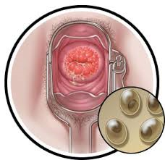
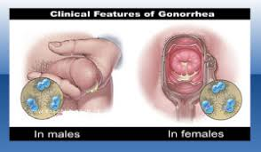
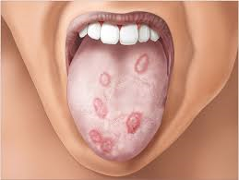
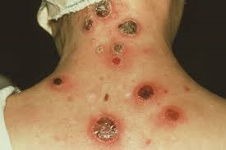
Bacterial: The best way to treat STBBI’s is prevention…..Use condoms
Chlamydia: common in both men and women, often
asymptomatic, causes infertility, is treatable.
Gonorrhea: common in young adults and teens, Asymptomatic, can cause infertility, itching and burning and very dangerous for babies. Can cause them blindness. Treatable.
Syphilis: common in women and men between
15 and 24. can be treatable. Very dangerous if left untreated.
Causes lesions in nerves, heart,
brain and blood vessels
can be passed to a fetus
cause death

Slide 39
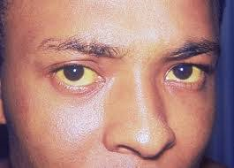
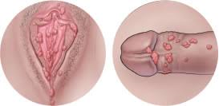
Viral: These infections cannot be treated easily. The best form of treatment is prevention. Use a condom and get a vaccination
HIV/ AIDS: this virus attacks the immune system so you can’t fight off other diseases like pneumonia and TB. It is eventually fatal. The treatment only slows down the process. No cure
Hepatitis B: causes liver failure, jaundice, Cancer.
This one is somewhat treatable.
There is a vaccine to protect you against it.
Herpes: a virus that causes cold sores in both your mouth and genital areas. Meds. treat flare ups which last about a week but the virus never goes away. You can experience flair ups several times a year.
Human Papilloma Virus (HPV): Causes gential warts. And leads to cancer of the cervix, penis and vagina. Warts can be treated but can return frequently.
There is a vaccine.

Slide 40
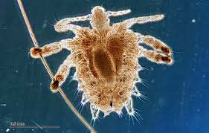
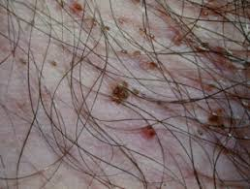
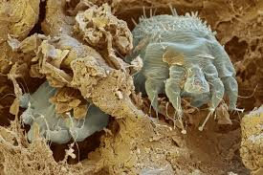
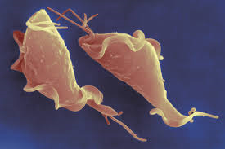
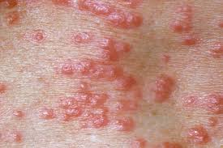
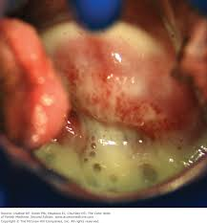
Parasites: the best way to treat these is prevention. Use condoms
Pubic lice and scabies: these are tiny mites( like little spiders)
Pubic lice live in the follicle of your pubic hair
Scabies lives under the skin
Both cause rashes and itching
Both are treatable with shampoos containing anti-parasitic medications.
Trichomonas vaginitis:
a protozoa that causes a greenish discharge from the vulva.
Treatable with medication. Can be spread without sexual contact

Slide 41
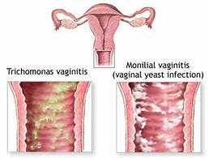
Fungal infections. The best treatment is prevention. Use condoms
Yeast infection: causes a white vaginal discharge. Lots of itching and discomfort.
Treatable with medication and topical cream
Not always transmitted with sexual contact

Slide 42
Take away
Contraceptive methods: stop you from getting pregnant, you may use many different methods in your lifetime.
Condoms: Help Prevent STBBI. Be safer use both.
Vaccinations: Prevent diseases. Get them!!
It’s very important to be in a trusting relationship if you want to get pregnant.

