Slide 1
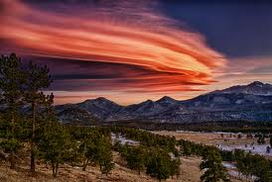
Geomorphology
The ever changing
shape of the earth

Slide 2
The evolution of a landscape
The earth is always in motion
Huge internal forces are affecting the earth
What is a force?
It’s energy or a mechanical action.
It can make an object move
It can change it’s direction
It can change it’s speed
It can distort

Slide 3
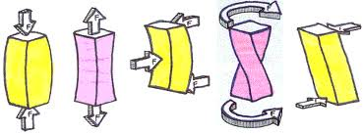
Types of forces (also called constraints)
compression
flexion
torsion
tension
Shearing

Slide 4
Earth’s Internal forces
Extreme differences in temperature of liquid mantle
Density differences of magma
Convection currents in the mantle
Move the floating “plates” of crust

Slide 6
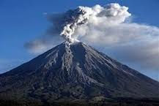
Some forces build up new shapes

Slide 7
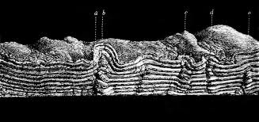
Effects on the crust
Folding Name the constraint
compression

Slide 8
Where does folding occur?

Slide 9
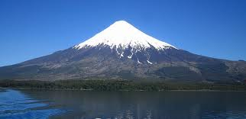
Rising up Name the constraint
Flexion

Slide 10
Where do volcanoes occur?
In subduction zones

Slide 11
Fracture Name the constraint
shearing

Slide 12
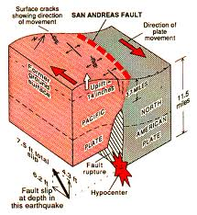
Where do rifts occur?
Where two plates slip past each other

Slide 13
Where do trenches occur?
Where one plate sinks below another

Slide 14
Spreading Name the constraint
Ten
sion

Slide 15
Where in this picture does spreading occur?
Where hot magma rises.
Mountains occur here too.

Slide 16
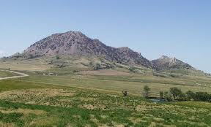
What a relief!
I mean what’s a relief
Mountains , valleys, trenches
All the shapes on the earth’s crust
Turn to Page 317 :
Name 3 place where plates are diverging
Name three plates that are converging
Name two places that have a lot of slips

Slide 17
Some forces wear shapes down
Weathering and Erosion

Slide 18
Weathering
Wind with sand and dust particles hitting rocks
Rain & snow infiltrating, freeze/thaw cycle
Is this physical or chemical change?
Physical
It breaks rocks without changing their composition.
We call this Mechanical Erosion

Slide 19
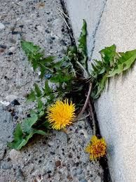
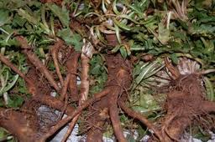
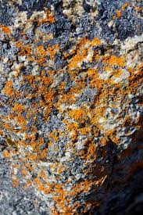
Biological Erosion
Tree roots infiltrate the rocks and soil and break them apart
Physical or chemical?
Physical
Organisms Like lichen create acids that attack the rock.
Physical or Chemical?
Chemical

Slide 20
Chemical Erosion
Human impact on the planet has caused
Pollution
Acid rain, acid snow, Acid precipitation
This reacts with limestone and marble
It changes the composition of other minerals and lakes
It is a chemical change

Slide 21
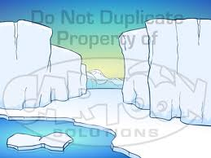
Transportation
Rock fragments are carried off by:
Wind
Water runoff
Glaciers grinding their way to the ocean

Slide 22
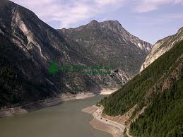
Transformation compounds the effect of erosion
Rivers carve V-Shaped valleys

Slide 23
Glaciers Carve U-Shaped valleys

Slide 24
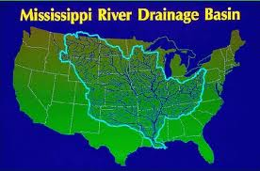
Sedimentation
River drain and carry sediments from large areas

Slide 25
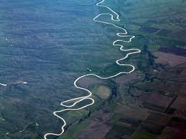
The rivers slow down and Meander along flood plains and drop some of their sediments
.

Slide 26
At the mouth of the river they slow down even more and spread out ,dropping their sediment load into a huge delta

Slide 27
Glaciers do the same thing but more slowly

Slide 28
Erosion
Flattens
Landforms
Read Pages 313-331
Answer Memory check questions.
P 321,324,327,328,and331

