Slide 1
How to Identify a Tree

Slide 2
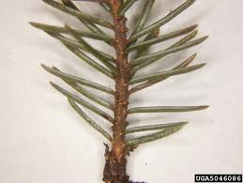
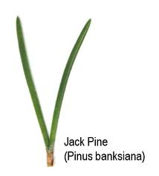
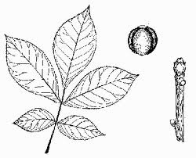
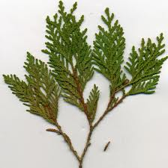
Collect a leaf or a needle
Whole
Lobed
Compound
Individual
Bundles
Scales

Slide 3
Look at the overall shape of tree
These are called sillouettes
Draw the sillouette
of your trees

Slide 4
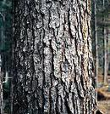
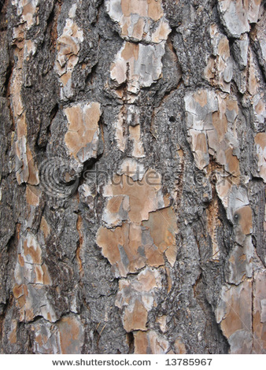
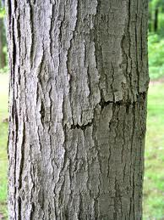
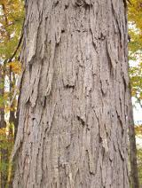
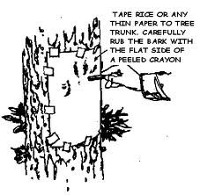
Look at the bark and do a rubbing
White spruce
Jack pine
Sugar maple
Shagbark hickory

Slide 5
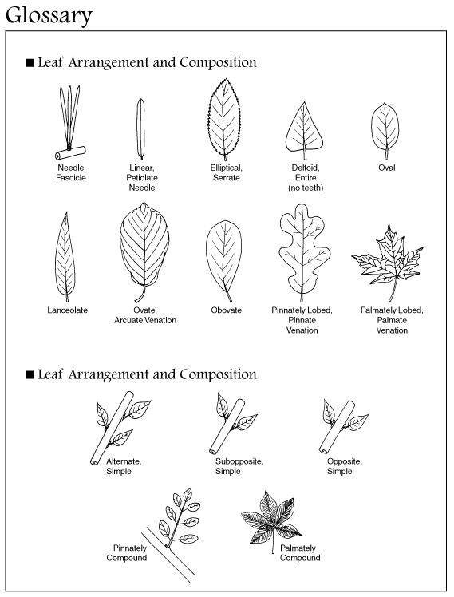
Look at a Tree key

Slide 6
Make a booklet Identify 4 maples species on the school property
1 page for each tree.
Include Preserved leaf
3 characteristics of the leaf that identifies it.
Common Name(s)
Scientific name Genus species
Research some Interesting facts about your tree

