Slide 1
Compressible &Incompressible fluids
How Pneumatics & hydraulics works

Slide 2
States of matter
There are three states of matter
Solid Has a definite shape and volume
Liquid Has a definite volume.
but can assume the shape of its container.
It flows.
Gas It can change its volume.
it can assume the shape of its container.
It flows

Slide 3
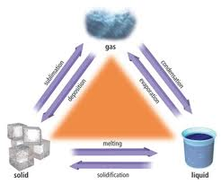
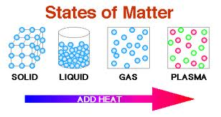

Slide 4
Fluids Flow and Find Form
Liquids and Gases are fluids
Liquids always keep the same volume. They cannot be squeezed into a smaller space.
They are incompressible
We use them in hydraulics.
Gases can be squeezed into a smaller space
They are compressible
We use them in spray paint and breathing

Slide 5
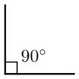
Pressure
Pressure is the result of a force applied at right angles to a surface area.
P=F/A
Pressure is measured in units called Pascals
Pa
KPa is 1000 pascals or 1 Kilopascal

Slide 6
Force
A push or a pull
It changes the movement of an object.
It can also be gravity or friction. Weight is a force.
Force is measured in Newtons.
Mass (kg) x 10 = Newton (N)

Slide 7
Surface area (m² )makes a difference
If the pressure is spread out over a large surface area, then there is less
force.
If the pressure is concentrated over a
small area, then there is more
force.

Slide 8
Compressible gasses
These gasses can be squeezed into a can.
Small area = high pressure (lots of collisions)
When you depress the button you open the can to the outside air.
Large area = low pressure (few collision)
The gas spreads out and leaves the can
Things always flow
From High to Low

Slide 9
Your lungs are Pneumatic they use compressible gas called air

Slide 10
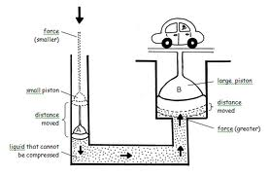
Hydraulics HowStuffWorks "A Hydraulic System"
Uses incompressible fluids like water or oil.
Contains 2 pistons connected by a closed chamber.
The pressure is the same on both sides.
If the surface area is the same, then
the force is the same.
If one cylinder is bigger you can
Increase your force.

Slide 11
The Trade off
The little cylinder (the one with the small surface area) is easier to push but you have to push farther.
Area = ∏r²
If radius r is 3x smaller then the force needed is 3² easier or 9 times easier.

Slide 12
Your heart is Hydraulic it uses an incompressible liquid called blood

