Slide 1
Mechanical engineering intro
Links and Guides

Slide 2
What is mechanical Engineering?
Definition:
Branch of engineering that focuses on the design, production, analysis, working and improvement of a technical object.
In other words it looks at how things work!

Slide 3
To understand how an object works one must consider:
Guides
Links
Motion Transmission
Motion Transformation
Speed change

Slide 4
Links
Linking is the mechanical function performed by any component that connect different parts of an object.

Slide 5
Links
Four key characteristics of a link
Direct vs. indirect
Rigid vs. Flexible
Removable vs. Non-removable
Complete vs. Partial

Slide 6
1: Direct vs. Indirect
A link is direct when two objects hold together without a linking component
A link is indirect when the parts need something else (a linking component) to hold them together
Ex: glue, sticky tack, nails, screws …
Glue

Slide 7
2: Rigid vs. Flexible
A link is rigid when the linking component or the surfaces of the linked parts are rigid
A link is flexible when the linking component or the surfaces of the linked parts can be deformed.
Ex: springs, rubber, Sticky tack

Slide 8
3: Removable vs. non-removable
A links is removable when the linked parts can be separated without damaging either the surfaces of the linking component.
Ex:. nail, screw, nut and bolts
A link is non removable when separating the linked parts damages their surface or the linking component
Ex:. glue

Slide 9
4: Complete vs. Partial
A link is complete when it prevents the linked parts from moving independently of one another
Ex:. nail …
A link is partial when at least one part can move independently of the other part
Ex:. hinges …

Slide 10
Linkages
Can the object be taken apart without causing damage to the object?
Non-removable
Is movement possible between the two parts?
Complete
Is the fastener that links the parts together flexible ?
Flexible
Do the parts require something else to hold them together?
Indirect
Direct
Rigid
Partial
Removable
no
yes
yes
no
no
yes
no
yes

Slide 11
Describe the type of link
direct or indirect,
rigid or flexible,
non-removable or removable,
complete or partial,
Indirect
Rigid
Removable
Partial
The “link” between the hinge and the doorframe:

Slide 12
Describe the type of link
direct or indirect,
rigid or flexible,
non-removable or removable,
complete or partial,
Direct
Rigid
Removable
Complete
The “link” between the pen and the cap:

Slide 13
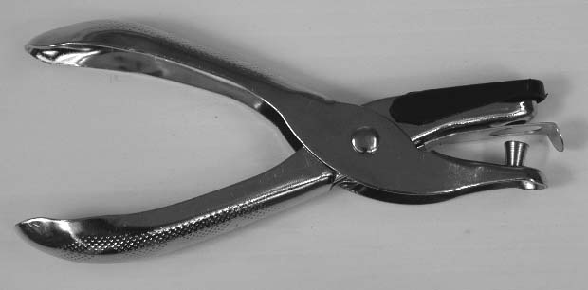
The types of « Links » between Parts
?
The “link” between the handle and the punch is:
direct or indirect,
rigid or flexible,
non-removable or removable,
complete or partial,
.
Direct
Rigid
Non-removable
Complete

Slide 14
The types of « Links » between Parts
?
The “link” between the bottom handle and the top handle is:
direct or indirect,
rigid or flexible,
non-removable or removable,
complete or partial,
.
Indirect
Rigid
Non-removable
Partial

Slide 15
The types of « Links » between Parts
?
The “link” between the bottom handle and the receptacle is:
direct or indirect,
rigid or flexible,
non-removable or removable,
complete or partial,
.
Direct
Flexible
Removable
Partial

Slide 16
Principle Types of Links
6 key types; based on the type of motion by the linked part
1: Fixed link: no movement

Slide 17
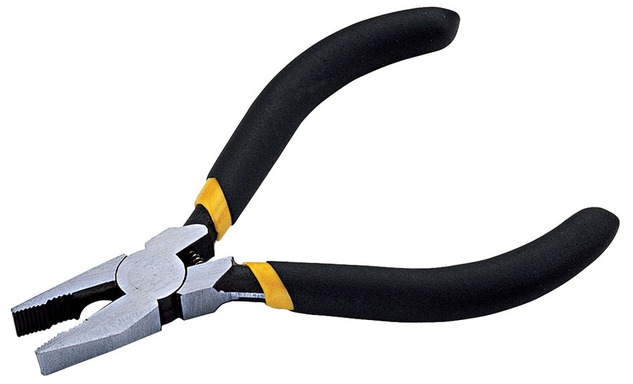
2: Rotating link: rotational movement around 1 axis

Slide 18
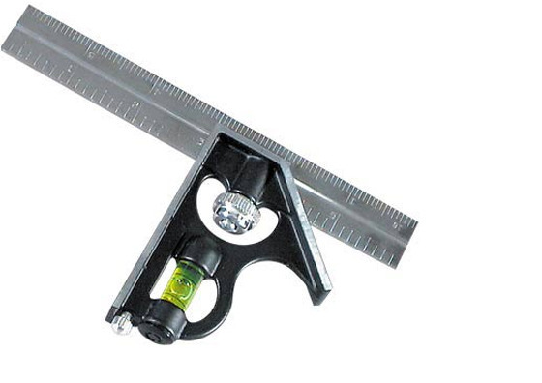
3: Sliding link: translational movement around 1 axis

Slide 19
4: Sliding/rotating link: rotational + translational movement around 1 axis

Slide 20
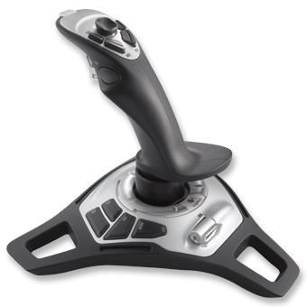
5: Spherical link: multiple rotational motion

Slide 21
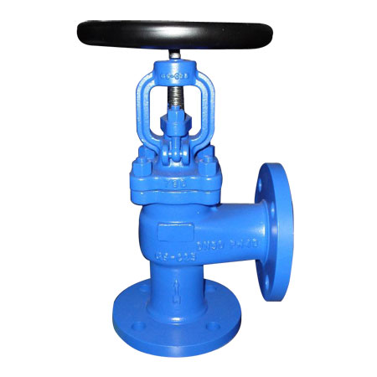
6: Helical link: helical motion

Slide 22
Guides
A guiding component is a component whose mechanical function is to guide the motion of moving parts
Types of guides
Translational guide
Ensures the straight translational motion of a moving part
Symbol for translational movement

Slide 23
Rotational guide
Ensures the rotational motion of a moving part
Symbol for rotational movement

Slide 24
Helical guide
Ensures a combination of translational and rotational motion of a moving part
Symbol for helical movement

