Slide 1
Materials and their Mechanical Properties
Deformations and how to resist them

Slide 2
What is Energy?
The ability to do work
This means to move and change objects

Slide 3
What is a technical object?
An object that we think up and make to help us do stuff. It’s made of material
A tooth brush
A mouse trap
A hydraulic arm

Slide 4
Okay so what is Material?
Raw material: It needs to be changed before we can use it.
A tree
iron ore.
Material: Already transformed and ready to use.
Dowel
Nail
Equipment
Tools
Hammer

Slide 5
Force or Mechanical Constraint
External force that makes internal changes in the material.
Compression
or push
Tension
or a pull
Flexion
or a bend
Torsion
or a twist
Shearing
or a tear

Slide 6
These constraints cause the material to Deform
Deformation… how the material is changed after the constraint is applied. Resistance is futile!
Types of deformations:
Elastic it regains it’s original shape.
Plastic it remains deformed (New shape)
Fracture it breaks or ruptures

Slide 7
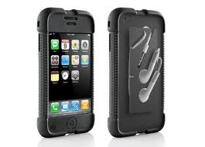
Properties of a material How a material reacts to a mechanical constraint
I will react to you…. Resistance is not futile
Hardness resists poking a hole
Resilience Resists impacts

Slide 8
Elasticity Stretches and regains origional shape.
Ductility Stretches and keeps new shape
Tensile strength Does not stretch (resists tension)

Slide 9
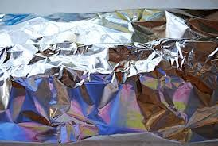
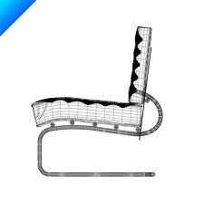
Malleability Flattens and bends without breaking.
Stiffness Resists bending or flattening

