Slide 1
Technical objects
Technical objects are made from materials.
Materials can be divided into three categories.
Raw Materials
Materials
Equipment

Slide 2
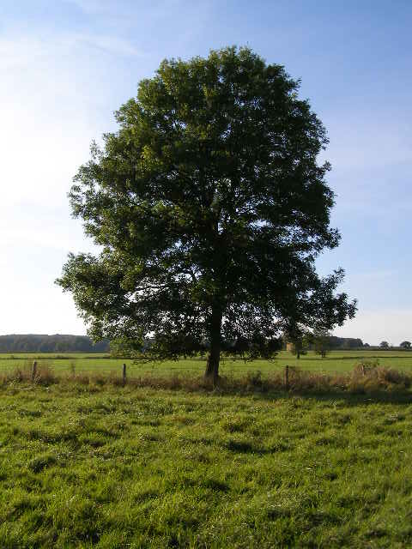
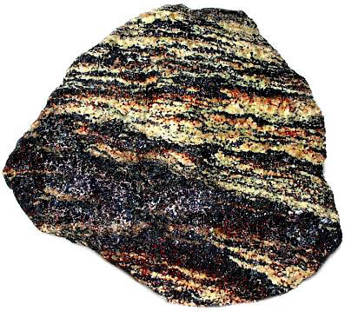
Materials
Raw Materials: substances that need to be transformed before they can be used to make a technological object.
Trees
Ore
Crude Oil

Slide 3
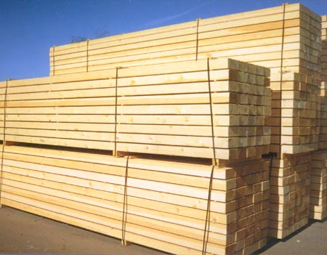
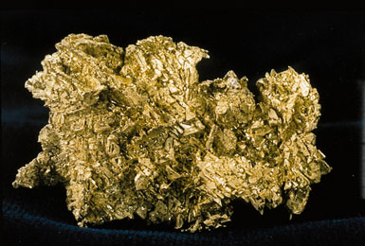
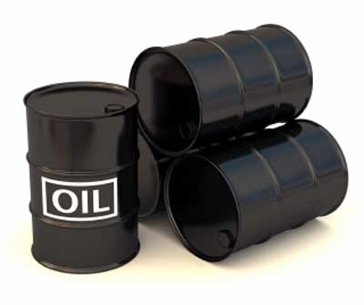
Materials
Materials: substances that have been modified by humans to make objects or parts.
Lumber
Gold
Oil

Slide 4
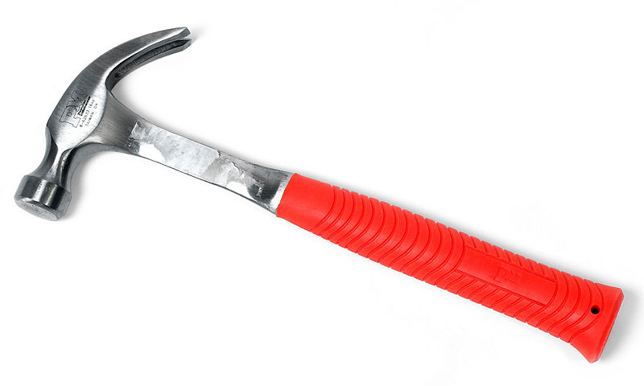
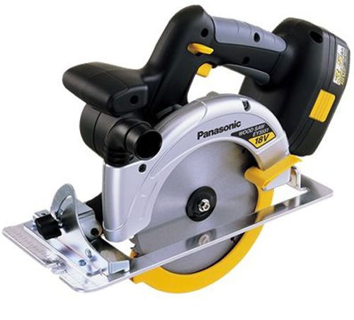
Materials
Equipment: all instruments used to produce technological objects.
Hammer
Saw

Slide 5
Mechanical Constraints
When selecting materials to produce technological objects, you need to know how they will react to different stresses.
Mechanical Constraints: stress produced on an object by an external force.
There are 5 basic constraints.

Slide 6
Mechanical Constraints
1. Compression: a force that crushes.

Slide 7
Mechanical Constraints
2. Tension: a force that stretches.

Slide 8
Mechanical Constraints
3. Torsion: A force that twists.

Slide 9
Mechanical Constraints
4. Deflection: A force that bends.

Slide 10
Mechanical Constraints
5. Shearing: a force that cuts or tears.

Slide 11
Deformations
Constraints result in deformations
There are three types:
Elastic: a temporary change, the object returns to its original form
Plastic: a permanent change, the object keeps its new shape
Fracture: a permanent change, the object breaks

Slide 12
Mechanical Properties
Different materials react in different ways to constraints.
For example, a stick of chalk will break easier than a stick of wood.
Mechanical Properties: determine how a material reacts to a constraint.
There are seven properties.

Slide 13
Mechanical Properties
1. Hardness: a material’s ability to resist denting or scratching.
Ex: A diamond has high hardness, it does not scratch or dent.

Slide 14
Mechanical Properties
2. Elasticity: a material’s ability to return to its original shape.
Ex: Slinky has high elasticity.

Slide 15
Mechanical Properties
3. Resilience: a material’s ability to resist shocks.
Ex: a rubber case helps an Ipod resist shocks.

Slide 16
Mechanical Properties
4. Ductility: a material’s ability to stretch and take a new shape.
Reacts to tension
Ex: elastic bands have high ductility

Slide 17
Mechanical Properties
5. Malleability: a material’s ability to bend.
Reacts to deflection or compression.
Ex: steel has high malleability, it bends without breaking

Slide 18
Mechanical Properties
6. Stiffness: a material’s ability to maintain its shape.
Opposite of Malleability
Ex: carbon fibre is used in F1 racing car frames and mountain bikes to help retain shape.

Slide 19
Mechanical Properties
7. Tensile Strength: a material’s ability to be stretched without breaking.
Opposite of ductility
Ex: the chain holding a wrecking ball needs high tensile strength.

Slide 20
Mechanical Properties
Different materials have different mechanical properties.
Because of this, different materials will react differently to the same mechanical constraints.

