Slide 1
Minerals
A review and an introduction

Slide 2
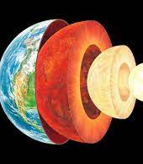
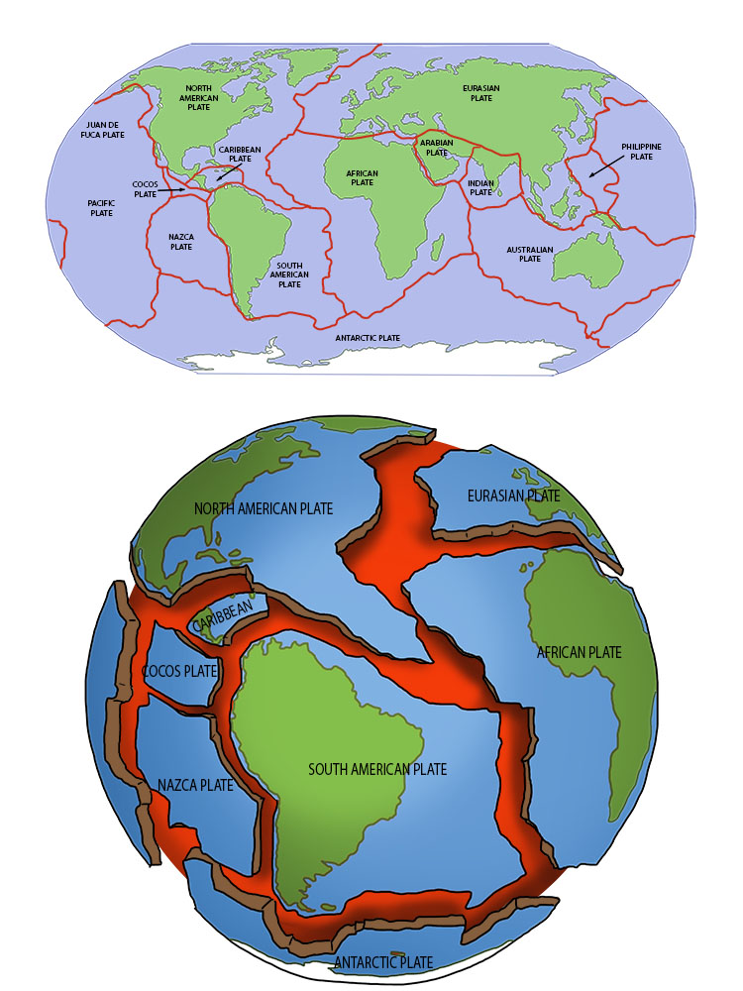
This is what you learned last year about the Earth
The earth’s internal structure has a core, a mantle and a crust.
The Lithosphere which is the Rocks in the crust and upper mantle including all the relief(mountains etc)
You learned about tectonic plates and how their movement creates volcanos, earthquakes, mountains
This relief is worn down by erosion

Slide 3
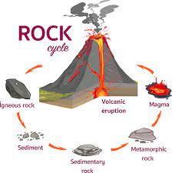
This year
We are going to look at the matter that the crust is made of.
Whether it is pure or a mixture.
Whether it’s made of atoms or molecules.
Whether it’s homogeneous or heterogeneous.
How they are formed.
How it can be identified with experimentation.
You will be using a dichotomous key again.

Slide 4
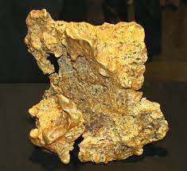
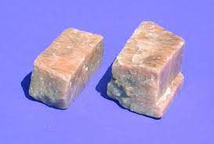
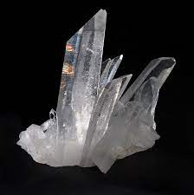
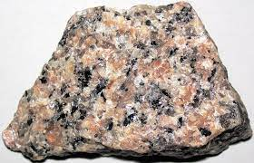
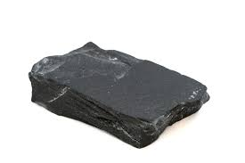
Matter
Anything that has mass and volume
Pure
Only one kind of substance
Mixture
Two or more substances physically mixed together
minerals
rocks
Atoms
molecules
solutions
heterogeneous
Gold (Au)
Feldspar
Quartz
slate
granite

Slide 5
Minerals are pure
A pure substance can be identified by characteristic properties.
Here are the tests you do to identify a mineral.
Write down a procedure for each test

Slide 6
Mineral Identification name of test definition procedure in your own words
Test
Luster
Hardness
Colour of solid
Colour of streak
Magnetism
Effervescence
Definition
How the mineral shines
Resistance to scratching
Colour on outside or freshly broken rock
The “crayon” mark a mineral leaves behind
Reaction to a magnet
Bubbles with acid

