Slide 1
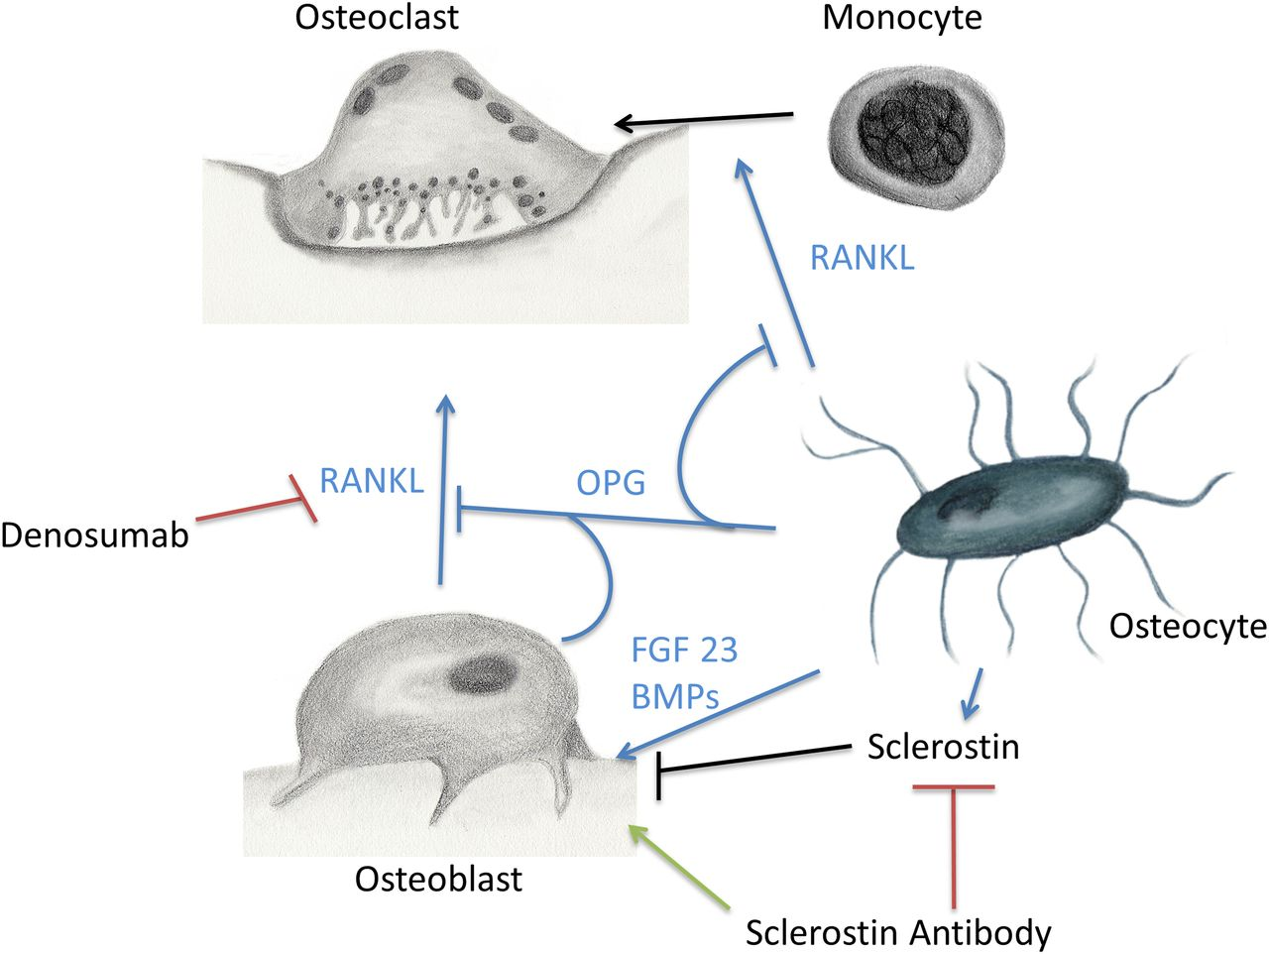
Osteocytes
Bone Cells or

Slide 2
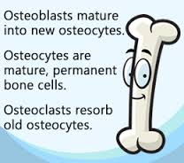
Bone is
made of living tissue - blood vessels, nerves, collagen, and living cells Including:
osteoblasts - cells that help form bone
osteoclasts - cells that help eat away old bone
osteocytes - mature bone cells which
exchange substances with blood
flowing through bones

Slide 3
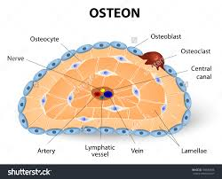
Bone is also
made of non-living substances - minerals and salts (calcium, phosphate)
assembled as a matrix –
a web of living cells with
minerals inside that help
to strengthen the bone.

Slide 4
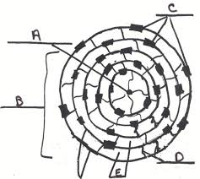
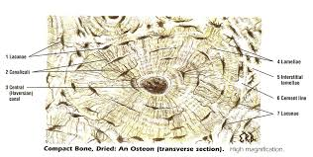
The bone tissue lines up in columns
Columns are very strong.
They are called osteons.

Slide 5
Osteons team up in columns to makes bones

Slide 6
Now you draw one

Slide 7
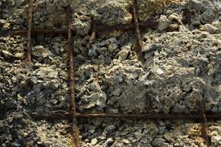
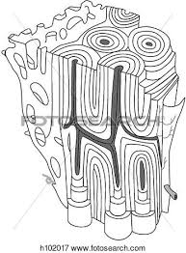
Compact bone vs Reinforced concrete
Reinforced concrete
Iron Bars
Sand cement and rock
Very low torsional strength
Compact bone
collagen - almost the same tensile strength as concrete
calcium - much higher compressional strength
very low torsional strength; often results in fractures

Slide 8
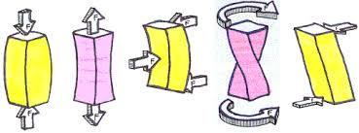
Bones must be able to resist 3 types of constraints or forces
Compression flexion torsion shearing
tension

Slide 9
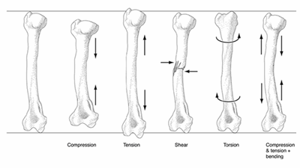
A constraint is a force applied to a material : say a bone perhaps
Compression tension shearing torsion all three

Slide 10
Deformations or what happens to the bone when a constraint is applied
There are three kinds of deformations:
Elastic: temporary change in shape. Bounces back to normal
Plastic: permanent new shape….. Crushing a can
Fracture: Permanent break…… this is what bones do

Slide 11
Types of
s

