Slide 1
Paper Chromotography
How to separate tree pigments

Slide 2
Why do trees change colour in the fall?
The leaf cells have several choroplasts that have a pigment in it
The CHLOROPLASTS contain chlorophyll which is green.
There is so much of it, it hides the other colours.
When the days get short the chlorophyll dies and the other colours show up
Xanthophyll is yellow
Carotene is orange
Anthocyanin is red

Slide 3
What is a pigment anyway?
A pigment is a molecule
It absorbs certain colours of light and reflects back the rest.
You see what is being reflected
Chlorophyll absorbs red and blue and reflects green
Anthocyanin absorbs orange yellow green blue purple and reflects red
The pigment molecules are all different sizes

Slide 4
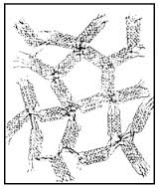
What happens when you dip a piece of paper towel in water?
The paper towel has little tiny holes and channels
Water is adhesive and sticks to the paper
Water is cohesive and sticks to itself
This lets the water climb up the tiny tubes
Capillary action
Anything that is dissolved in the water will climb too.

Slide 5
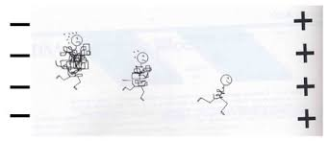
Matter has mass and takes up space and has a shape
This is a method for separating molecules that have a different :
shape,
size
Smaller more stream lined go faster
Bigger molecules go more slowly

Slide 6
Let’s try it!
How many colours are there in the markers?
Which pigment is the biggest ?
Which pigment is the smallest?
Before
Filter paper
Pigment spot
water

Slide 7
After
Draw the strip of filter paper
Use colours

Slide 8
Let’s try it with the leaves
Place a small amount of sand and
10ml of alcohol in a mortar and pestle
Place your spinach leaves in the mortar and pestle
Grind them till all the alcohol looks green.
Filter the green liquid into a beaker
Place a paperclip through the end of the paper
Balance it so the tip of the paper is in the green liquid
Wait about 5 min. Put your initials on the top of the paper pin it to the board to dry
Clean up.

