Slide 1
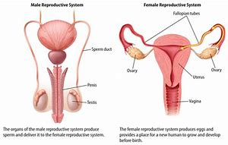
Human reproductive Anaomy

Slide 2
Why is Reproduction important?
One of the characteristics of life is that it has a definite life span.
That means we die.
Without reproduction our species would go extinct.
A species : 2 organisms that can reproduce and have fertile offspring.

Slide 3
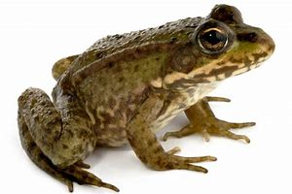
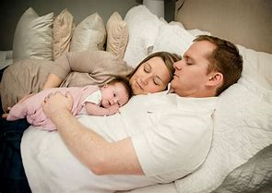
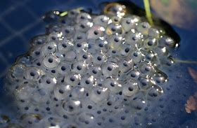
Successful reproduction mean having grandchildren.
How successful you are depends on :
how many offspring are produced
The amount of parental care
Frogs lay thousands of eggs Humans usually have one at a time
but don’t care for them And care for them 20 years

Slide 4
What are organs tissues glands and ducts?
A bunch of cells that team up to do 1 job is a tissue
Blood, Bones, skin, ovarian tissue
An Organ is a group of tissues that work together to do one job
Heart, ovary, testicle, lung
A Gland is a group of cells that produce a fluid or substance and export it into the body or blood
Pituitary gland , prostate, pancreas, salivary glands
A Duct is a small tube
vas deferens, fallopian tubes, tear duct

Slide 5
Male anatomy

Slide 6
Internal organs Structure and Function
Testicles
Epididymis
Vas deferens
Seminal vesicles
Prostate
Urethra
Cowper’s gland
a gland that produces sperm by meiosis and makes testosterone
A duct next to the testes where the sperm collect and wait around (death or ejaculation whichever comes first)
Duct that leads from epididymis to the prostate and ampulla
Glands that produce a liquid that feeds the sperm.
Gland that produces a liquid that activates and feeds sperm
Duct that both urine and sperm are expelled through
A gland that cleans and lubricates the end of the penis during intercourse.

Slide 7
External male anatomy
Scrotum
Penis
Glans
Prepuce or foreskin
Urinary meatus
Semen
Sac that contains the testes and epididymis and start of vas deferens
Long genital organ characteristic of males. Covered with a thin layer of skin
Bell shaped tip of penis
The skin that covers the glans and is removed during a circumcision.
Opening in the glans through which urine and semen exit.
The sperm plus all the fluid made by the glands along the way

Slide 8
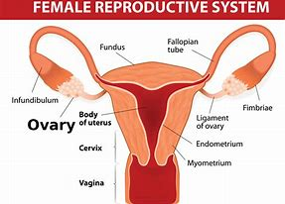
Female anatomy

Slide 9
Internal organs
Ovary
Fallopian tubes
Uterus
Endometrium lining
Cervix
Vagina
Bartholin’s gland
Small glands that produce ova, and female hormones estrogen and progesterone
Ducts that carry the egg from the ovary to the uterus. Usually fertilization happens here.
Thick stretchy organ with lots of muscles and a lining with lots of blood. Fertilized egg develops into a baby here.
Fills with blood to nurture fetus or sheds during menstruation.
Opening at the lowest part of uterus. Widens during childbirth.
Stretchy flexible tube. Allows penis to enter, baby or menstrual blood to exit .
Lubricates Vulva during intercourse.

Slide 10
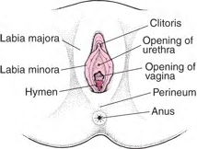
External organs
Labia Majora
Labia minora
Vaginal opening
Clitoris
Hymen
Urinary meatus
Outer 2 folds of skin that cover the labia minora
2 thin folds of skin that protect the vaginal opening
Vagina
Small sensitive organ at the top of the labia minor. It is protected by a small hood of skin
Thin membrane of skin that partially covers the vagina. Can be torn during intercourse.
Opening to your urethra. Exit for pee

