Slide 1
Respiratory system
In goes the good air
O₂
Out goes the bad air
CO₂

Slide 2
What two tissues do we use to move our bodies?
Bones (connective)as levers
Muscles (Skeletal)to contract and cause movement.

Slide 3
Which bones and muscles do we use to breathe
Rib cage

Slide 4
Which muscles do we breathe with?
Diaphragm and intercostal muscles

Slide 5
Air is a compressible fluid
Air is a mixture of gases.
Gases flow
Gases can change their volume
Gases are compressible they can be squeezed.

Slide 6
Air pressure
Big space low pressure
Small space High pressure
Few collisions
Lot’s of collisions

Slide 7
Air always flows from High pressure to low pressure
HI
lo

Slide 8
How do we change the shape in our lungs in order to Increase the volume
Inhalation
Intercostal muscles contract.
Ribs go up and out.
Diaphragm contracts.
Diaphragm goes down.
Volume of lungs increases

Slide 9
How do we change the shape of our lungs so that the volume decreases?
Exhalation
Intercostal muscles relax
Ribs fall down and in
Diaphragm relaxes and goes up
Volume decreases

Slide 10
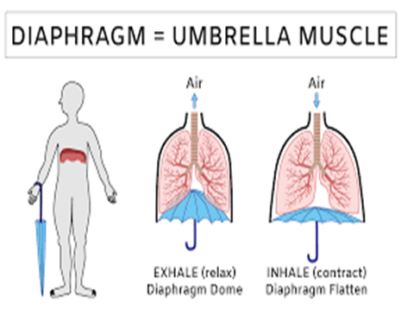
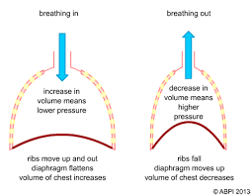

Slide 11
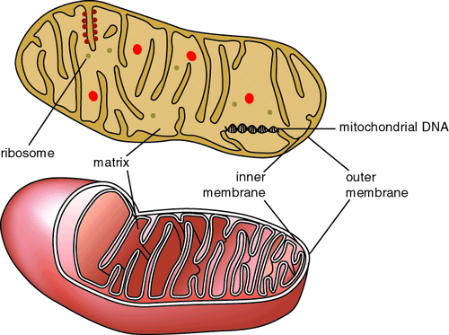
The Purpose of the Respiratory system
Carry Oxygen deep into your body near your blood
Blood carries oxygen to
Every cell in your body
Every cell in your body use O₂ to burn Glucose
to make energy.
This happens in a small organelle in your cell
called the mitochondria.

Slide 12
Cellular respiration
This process where you burn glucose with oxygen to make energy is called
Cellular Respiration
Respiration works backwards too.
It gets rid of waste products
CO₂ and Water

Slide 13
Question?
Your blood and the air sacs in your lungs get really close but they don’t touch.
How does the oxygen in the air move into your blood?
You learned about it last year.
Diffusion

Slide 14
Pathway to the cell
This requires 2 systems
Respiratory system brings the air from the outside and carries it really close to the blood (but not touching it)
This allows Oxygen (O₂) to diffuse into the blood.
Circulatory system carries oxygenated blood close to (but not touching) every cell in the body
This allows Oxygen (O₂) to diffuse into the cells.

Slide 15
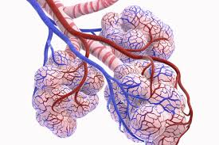
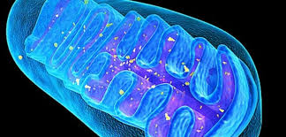
alveoli →mitochondria→and back
al

Slide 16
Diffusion is a movement of particles from a high concentration to a low concentration
Concentration of O₂ in the air in alveoli =21%
Concentration of O₂ in deoxygenized blood = 17%
Things always flow from
Will the oxygen move from the
Lungs to the blood or
Blood to the lungs?
High
Low

Slide 18
Diffusion is a movement of particles from a high concentration to a low concentration
Concentration of O₂ in the oxygenated blood =21%
Concentration of O₂ inside the cell = 17%
Things always flow from
Will the oxygen move from the
Blood to the mitochondria in the cell or
From the cell to the blood?
High
Low

Slide 20
Diffusion is a movement of particles from a high concentration to a low concentration
Concentration of CO₂ inside the cell after respiration=3-4%
Concentration of CO₂ in the deoxygenated blood =1-2%
Things always flow from
Will the CO₂ move from the
Blood to the cell or
From the cell to the Blood?
High
Low

Slide 22
Diffusion is a movement of particles from a high concentration to a low concentration
Concentration of CO₂ inside deoxygenated blood=3-4%
Concentration of CO₂ in the alveoli in the lungs=1-2%
Things always flow from
Will the CO₂ move from the
Blood to the lungs or
From the lungs to the Blood?
High
Low

Slide 24
To sum up: to get energy ATP
Diffusion happens in 4 places
with 2 different gas particles O₂ and CO₂
Cellular respiration changes O₂ into CO₂
Cellular respiration

