Slide 1
Review of sec 1 concepts
Species: Definition and naming
Taxonomy
Scientific name
Species : Niche
Adaptations
Habitat
Food chain
, Eco systems and
Biomes

Slide 2
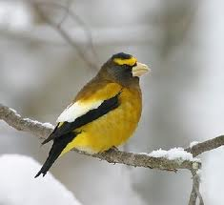
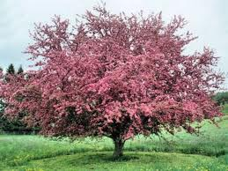
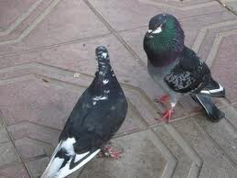
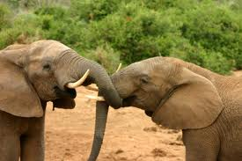
What is a species?
A species is a living organism
Two organisms belong to the same species if they:
Look similar
Can reproduce
Produce fertile offspring

Slide 3
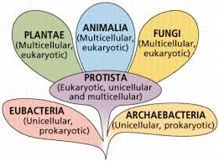
Taxonomy or How do you name an organism
There are 6 groups of different kinds of cells so there are 2 domains and 5 kingdoms.

Slide 4
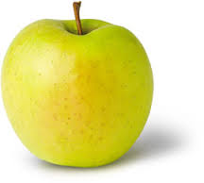
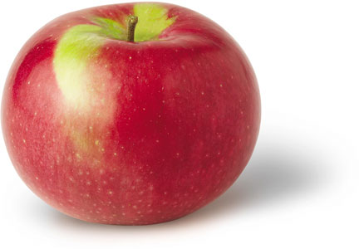
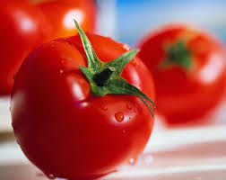
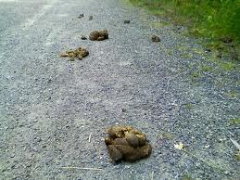
Scientific name vs common name
Common Names :can cause confusion when the same name is used for different things.
Golden delicious apple
MacKintosh apple,
Love apple,
Road apple.

Slide 5
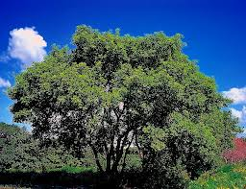
Two different names same tree
Box Elder Manitoba Maple
Common names cause bad communication.

Slide 6
Scientific Names
Are all in the same language.....Latin
(when you use a foreign language you always put it in italics....Voila).
It’s a dead language that no one speaks so no country’s scientist is better than any other and we can all understand what we are talking about.
The order of taxonomy:
Kingdom Phylum Class Order Family Genus Species
King Philip cried out “for goodness sake”

Slide 7
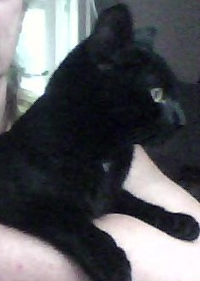
Domestic cat .....meow
Kingdom
Animalia
Phylum
Chordata
Class
Mamalia
Order
Carnivora
Family
Felidae
Genus
Felis
species
catus
Felis catus

Slide 8
How living things are organized in groups
Populations: all the same species in the same place at the same time.
All the frogs in the pond this Fall.
Communities: all the populations in the same place at the same time.
All the plants and animals in the pond this Fall.
Ecosystems: all the communities in the same place at the same time plus all the nonliving components of the habitat.
All the plants and the animals and the water, oxygen, nutrients in the pond this Fall.

Slide 9
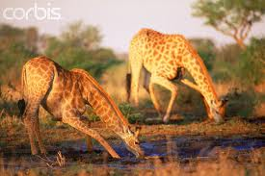
Habitat
Habitat: The environment in which a specific species lives. It provides them with shelter
food (food chain and flow of energy)
and opportunity to meet members of the opposite sex.

Slide 10
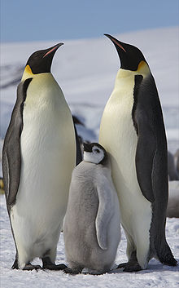
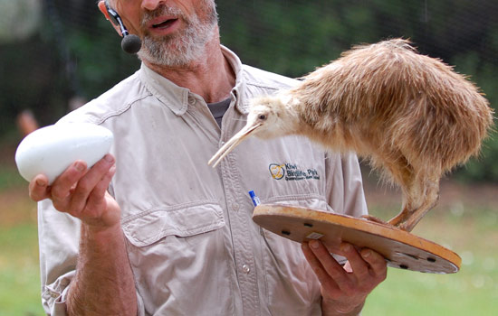
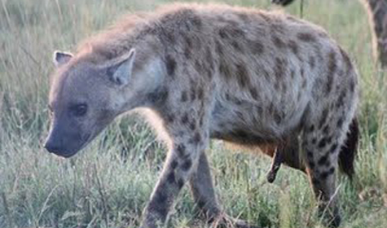
Adaptations
Adaptations: Physical attributes or behavioral habits that help an organism to survive.

Slide 11
Niche
Niche: Includes the living environment of all the members of a species, as well its diet and cycle of activity.
It is the habitat, physical and behavioral adaptations for the whole population.

Slide 12
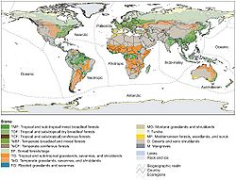
Biomes of the world
Giant global ecosystems based on
Temperature, rainfall, and dominant plant species

Slide 13
Importance of forest biomes
Forests represent a third of the earth's land.
The major attribute of the forest biome is its trees. While humans and animals breathe in oxygen and exhale carbon dioxide, trees take in carbon dioxide and produce oxygen.
Deforestation represents a great threat to the future of the earth's atmosphere. Once a tree is cut down, another should take its place, but there is still too large a number of trees being cut down as opposed to the number of trees being planted.

Slide 14
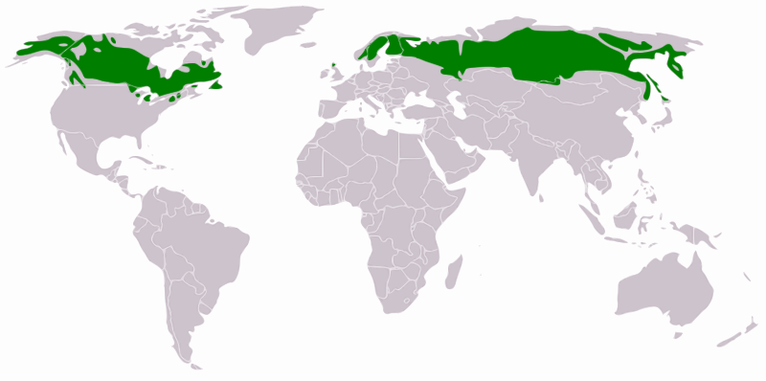
Taiga/Boreal Forest
Although this biome is correctly named Taiga, the term Boreal forest is usually used to refer to the more southerly part of the biome, while the term Taiga is more often used to describe only the more barren northern areas of the Arctic tree line.

Slide 15
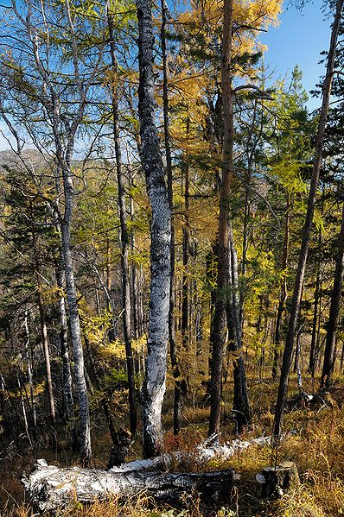
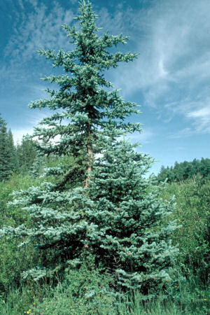
The annual temperature ranges from +30°C to -30°C
Precipitation: Precipitation varies, from about 20 cm of precipitation per year to over 200 cm. Much of the precipitation, of course, is in the form of snow.
Trees Mostly conifers Black Spruce and Balsam Fir and some White Birch

Slide 16
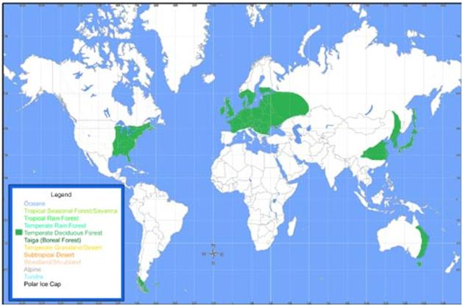
TEMPERATE DECIDUOUS FOREST BIOME
Map:

Slide 17
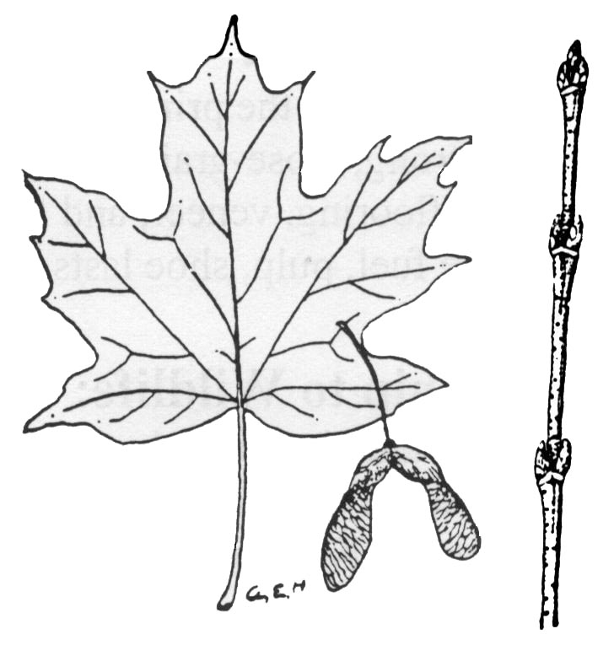
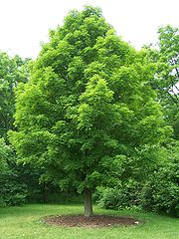
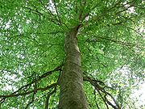
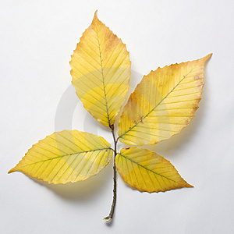
Temp. Range:
Precipitation:
Trees:
Sugar Maple
The average annual temperature ranges up to about 20° C down to freezing.
Precipitation ranges from around 50 cm yr⁻¹ in the colder regions to over 200 cm/yr.
The dominant trees vary as you go north or south in the temperate range. Our dominant trees are the Beech / Maple forests
American Beech

Slide 18
Mediterranean Forest
These regions are home to a tremendous diversity of habitats and species. Vegetation types can range from forests to woodlands, savannas, shrublands, and grasslands; :
Temp. Range :Warm subtropical
Precipitation: Semi arid less than 1000mm per year

Slide 19
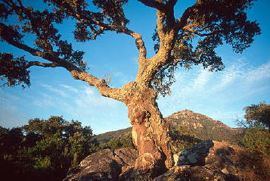
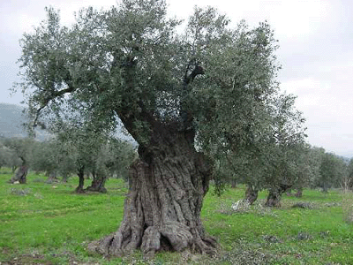
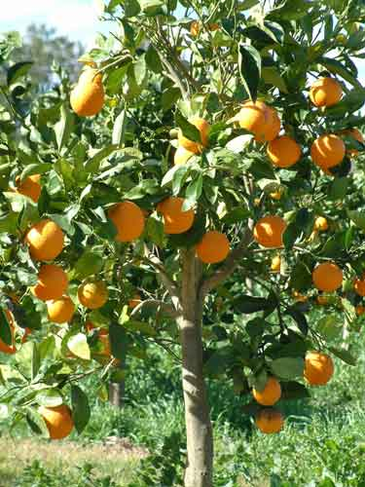
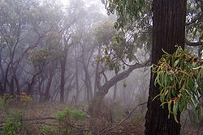
Trees of the Mediterranean forest
Mediterranean Forest
Olive
Cork Oak
Orange Eucalyptus forest
Orange tree
Cork Oak tree

Slide 20
Tropical Savana
Climate. A tropical wet and dry climate predominates in areas covered by savanna growth.
Mean monthly temperatures are at or above 64° F
Annual precipitation averages between 30 and 50 inches. For at least five months of the year, during the dry season, less than 4 inches a month are received. The dry season is associated with the low sun period

Slide 21
Tropical Savannas of the world

Slide 22
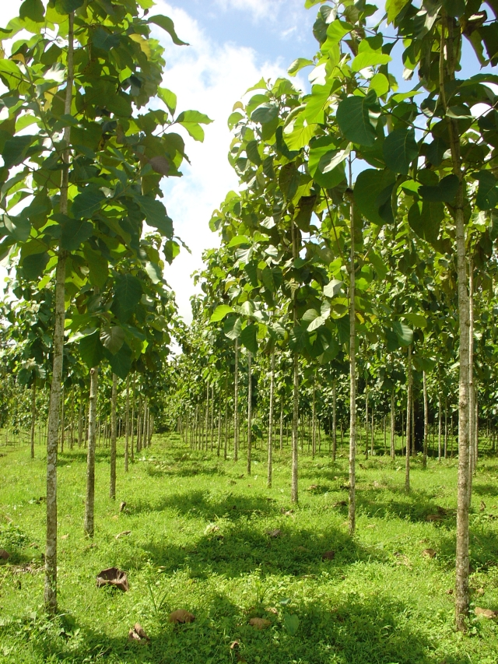
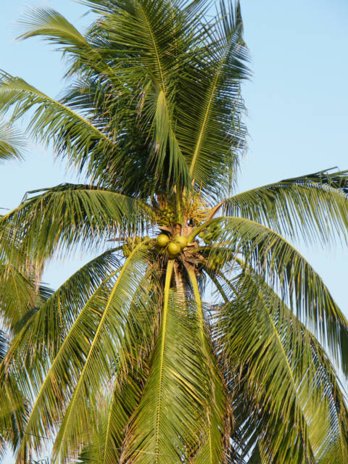
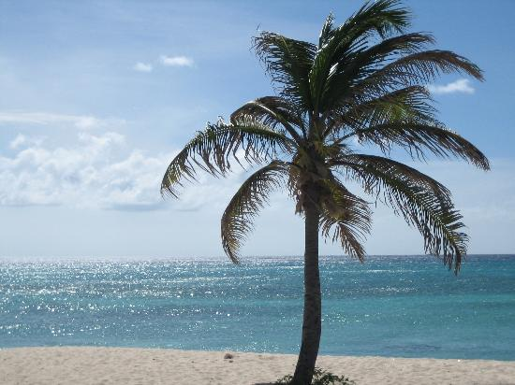
Tree Savannah
Teak
Date
D Palm

Slide 23
Tropical Forest The tropical rain forest is a forest of tall trees in a region of year-round warmth. Almost all rain forests lie near the equator.
:Map:
Temp. Range: The temperature in a rain forest rarely gets higher than 93 °F (34 °C) or drops below 68 °F (20 °C);
Precipitation: Rain forests belong to the tropical wet climate group. average humidity is between 77 and 88%; rainfall is often more than 100 inches a year. An average of 50 to 260 inches (125 to 660 cm.) of rain falls yearly. Tropical Forest

Slide 24
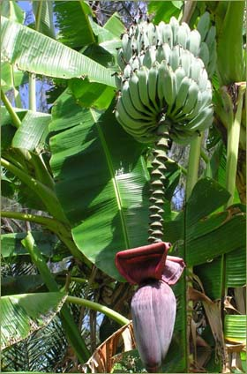
Trees of the tropical rain forest

