Slide 1
Synovial joint
Movement
Constraints, properties and deformation
Hydraulics and levers in action

Slide 2
Synovial joint
Where 2 bones are linked together
They are linked so that they can move
They contain a space or a sinus filled with fluid
This acts like hydraulics and transmits the force or constraint without letting the bones crunch

Slide 4
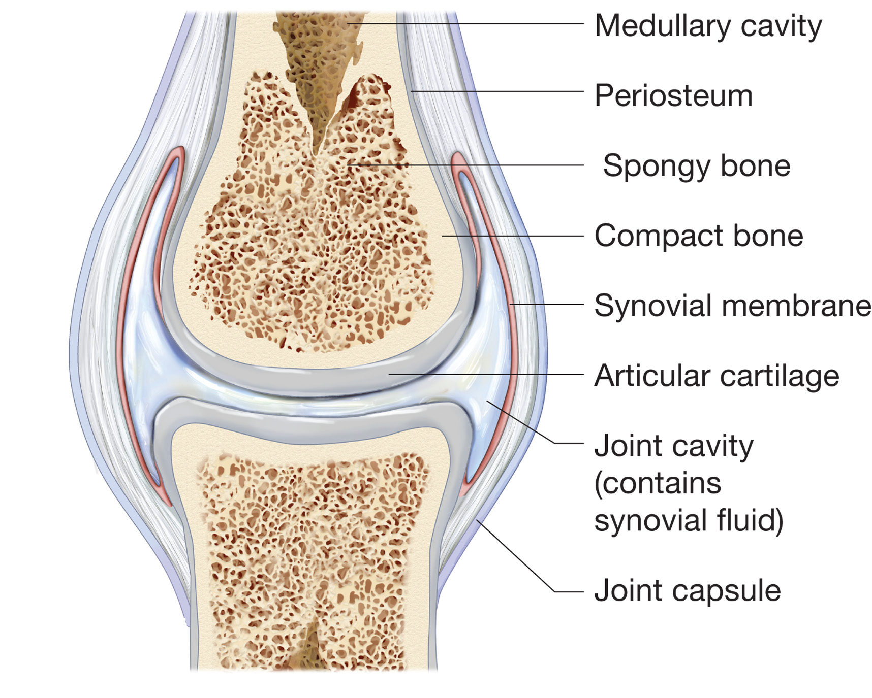

Slide 5
Synovial joint
Parts of the joint
Functions
Hollow, makes bone light, strong & makes blood cells
attaches tendons & ligaments, heals bone.
Lightness & strength, structure
Gives bone strength
Produces fluid
Protects end of bone ease of movement.
lubrication ( best known), cushions shock, use hydraulics
Tough fiber protects joint

Slide 6
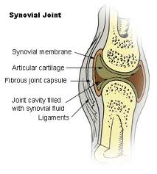
Bone
Bone Function
It supports the body
It acts as a lever to move the body
It’s both light and strong
Bone properties
Hardness (Rigidity)
Resilience
Tensile strength (not elastic)

Slide 7
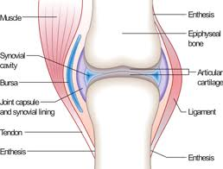
muscle
Muscle function
Contract
Move joint
Muscle property
Tensile strength (Some)
Elasticity (High)

Slide 8
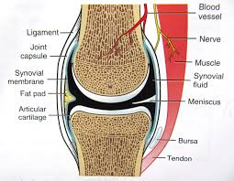
Tendon
Tendon function
Attaches muscle to bone
Holds and stabilizes the joint
Helps move the joint
Tendon properties
Tensile strength high
Low elasticity
flexible

Slide 9
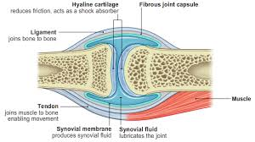
ligament
Ligament function
Ties bone to bone
Supports and stabilizes joint
Ligament properties
Lots of tensile strength
No elasticity (Like rope)
flexible

Slide 10
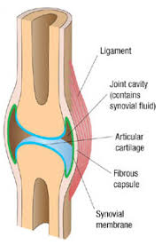
Synovial Cartilage
Cartilage functions
Protect end of bone
Reduce friction
Allows bones to move
Cartilage properties
Resilient
Hard
Smooth
slippery

Slide 11
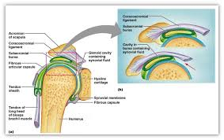
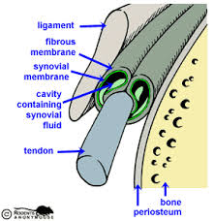
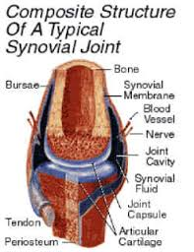
Synovial fluid
Synovial fluid function
Reduce shock
Lubricate joint
Protects tendons, ligaments &bursa
Synovial fluid properties
Non compressible fluid
(your joint is hydraulic)
Extremely lubricating low in friction

Slide 12
Your task
Choose a synovial joint in your body
Use materials that have the same properties as the parts of the synovial joint.
Research your joint well
Design and build a model of a synovial joint.
Due Oct.

