Slide 1
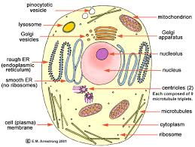
The cell (sec2)
Draw a picture and write the notes beside each organelle.
Anatomy: what it looks like.
Physiology: What it does

Slide 2
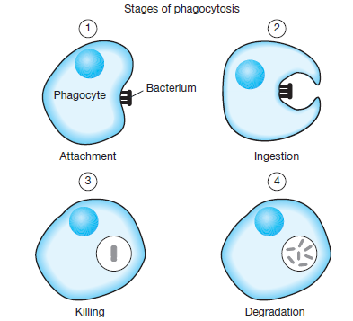
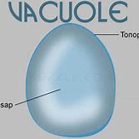
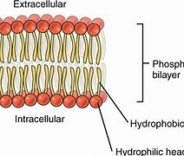
The cell Membrane and associates
Membrane
A lipid bilayer that controls what comes in and out of the cell.
Protects the cell from the outside environment.
Vacuole
lots of bubbles surrounded by a single membrane.
They hold water, waste products, food,
and proteins and vitamins that the cell makes
and wants to export.

Slide 3
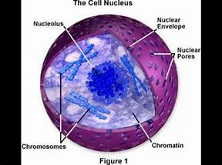
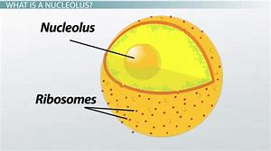
The nucleus and related structures.
Nucleus
The boss of the cell.
Contains the DNA which are all the instructions for making proteins.
Nuclear envelope
Surrounds and protects the nucleus. Controls what goes in and out
DNA never leaves the nucleus
Nucleolus
Loose structure in the nucleus, no memebrane. Darkish spot
Makes RNA and Ribosomes

Slide 4
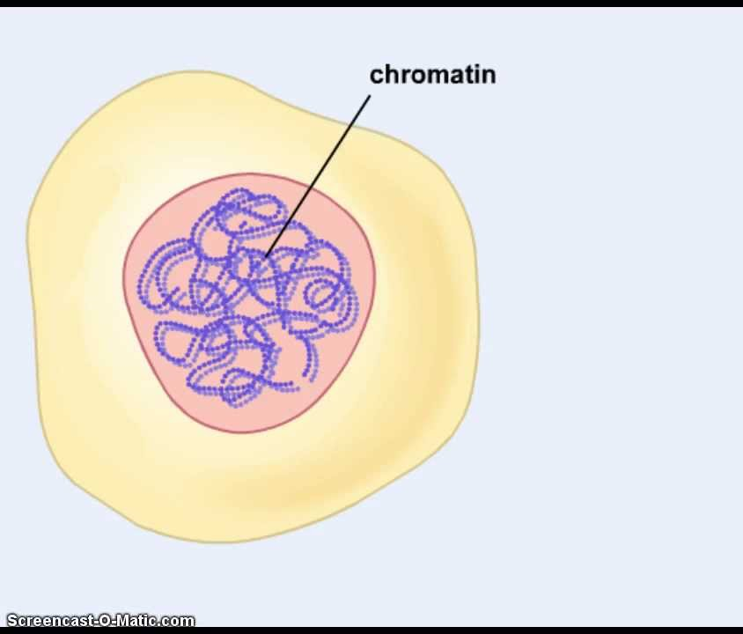
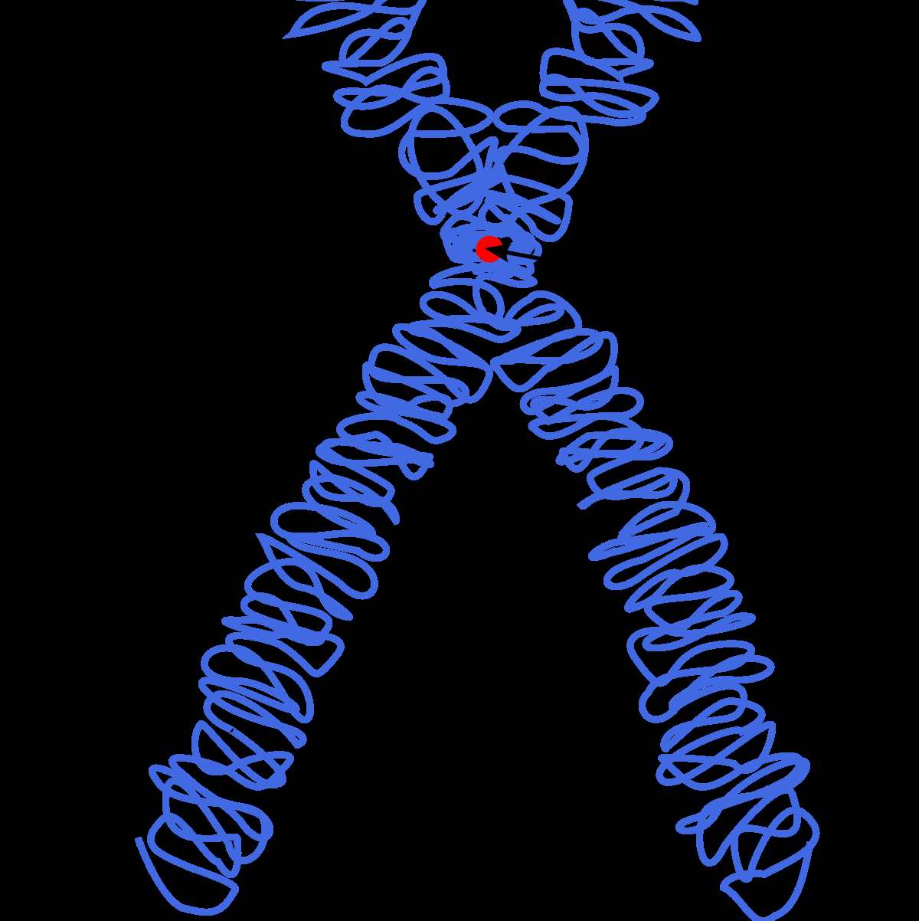
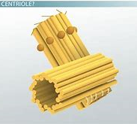
DNA and related structures
Chromosomes
They look like dark x’s
This is tightly coiled DNA
It coils up in order to divide
Centrioles
These look like two logs outside the nucleus
The centrioles pull the chromosomes apart during cell division

Slide 5
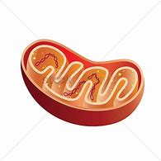
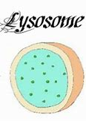
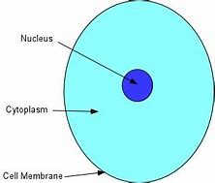
Cytoplasm and some organelles
Cytoplasm
The area in the cell between the nucleus and the cell membrane
It contains a jelly like substance called CYTOSOL
It also contains all the organelles
It supports the organells and dissolves nutrients and wastes in the cell.
It’s mostly water.
Mitochondria
looks like a jelly bean with a wiggly line inside
It produces energy (ATP) using Cellular respiration.
Lysosome
A sac containing powerful digestive enzymes
Can kill intruders
Digest and recycle the cell when its old or damaged
The suicide sac

Slide 6
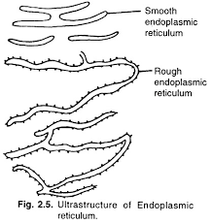
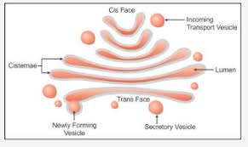
More organelles
Golgi Apparatus
This looks like a wifi symbol with bubbles
It processes fats and proteins and wraps them in a membrane for export.
Endoplasmic reticulum ( lovingly called E.R.)
A ribbon of membrane that transports stuff all through the cell.
Rough ER
has dots or ribosomes.
It is the site of protein synthesis
Sometimes free ribosomes float around in the cytoplasm.
They make proteins too.
Smooth ER
Makes fats and vitamins

