Slide 1
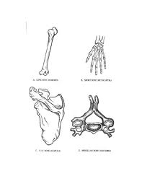
Types of Bones
Bones

Slide 2
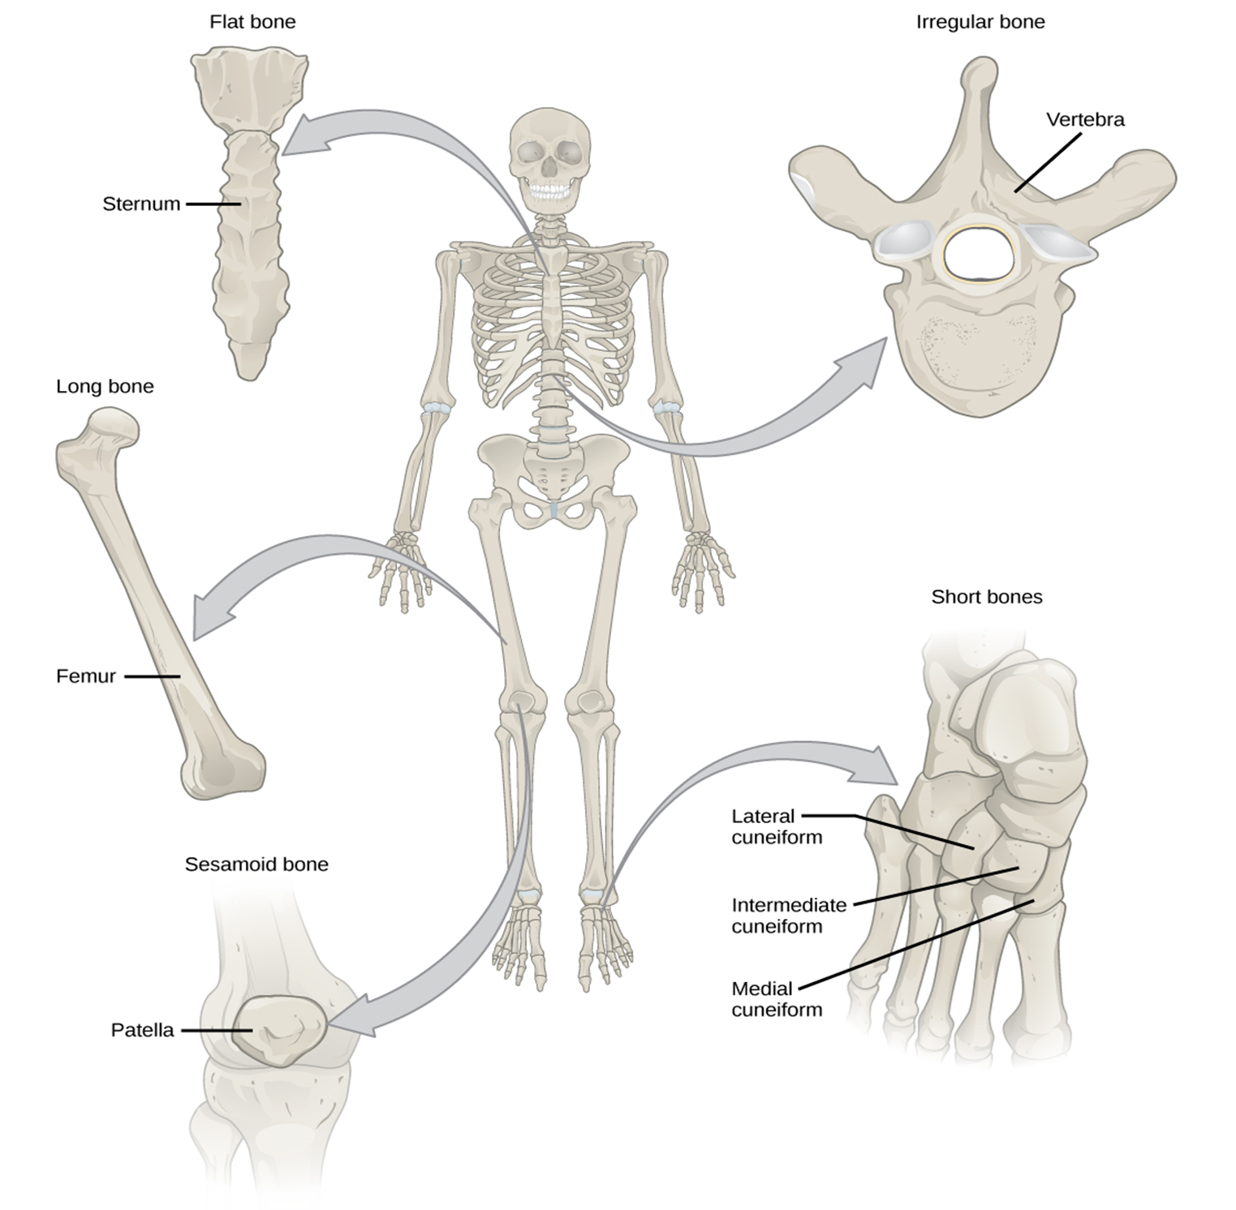

Slide 3
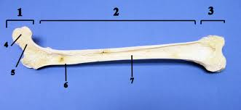
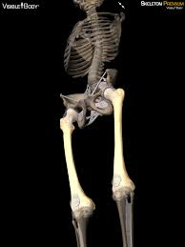
Long bones
E.g. Femur, humorous Function
Attaches muscles
Provides support
Makes blood cells
Stores calcium

Slide 4
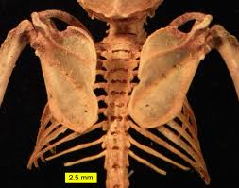
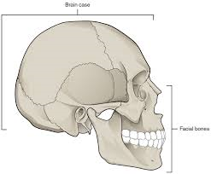
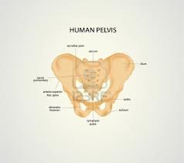
Flat bones
E.g. Scapula
Costals (ribs)
Cranium
Pelvis
Functions:
Provides a large surface for muscle attachment.
Surrounds and protects soft organs like brain, heart and lungs

Slide 5
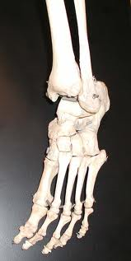
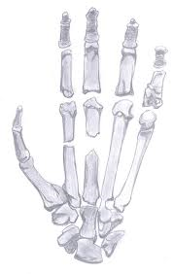
Short bones
E.g.
Carpals
Tarsals
Allow for movement in many directions
Gives strength and flexibility
Cubic in shape

Slide 6
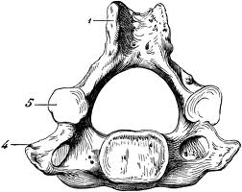
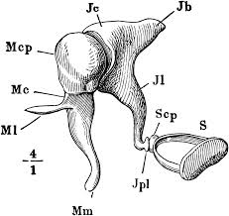
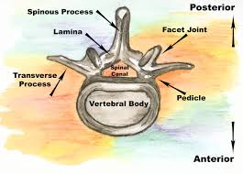
Irregular Bones
E.g.
Vertebra
Ossicles (Small bones in the ear)
Unique
Weird shaped bones
Ossicles help you hear
Vertebrae help you move they are flexible and strong
Protect inner spinal chord

