Slide 1
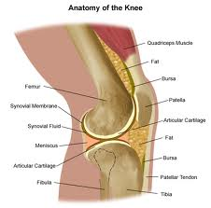
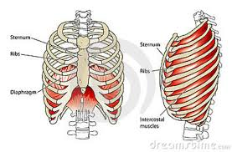
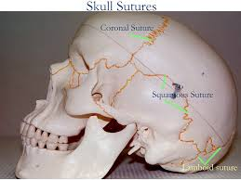
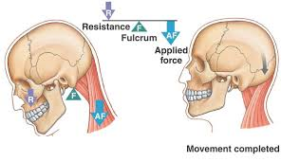
Types of Joints
And how they move

Slide 2
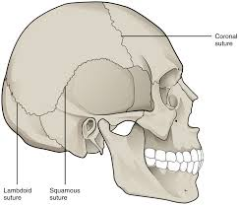
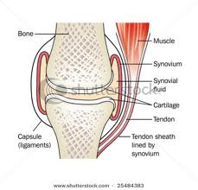
Joints
A joint is a junction between 2 or more bones.
They are a link
They can be direct
or indirect

Slide 3
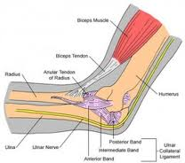
Rigid or flexible

Slide 4
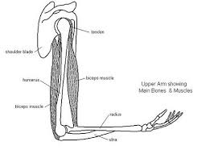
Complete or partial

Slide 5
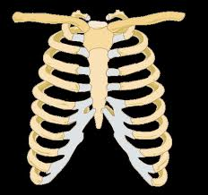
Generally all bones are non removable

Slide 6
How much do they move?
Fixed joint they don’t move
Some joints only move a little these are
Partial joints

Slide 7
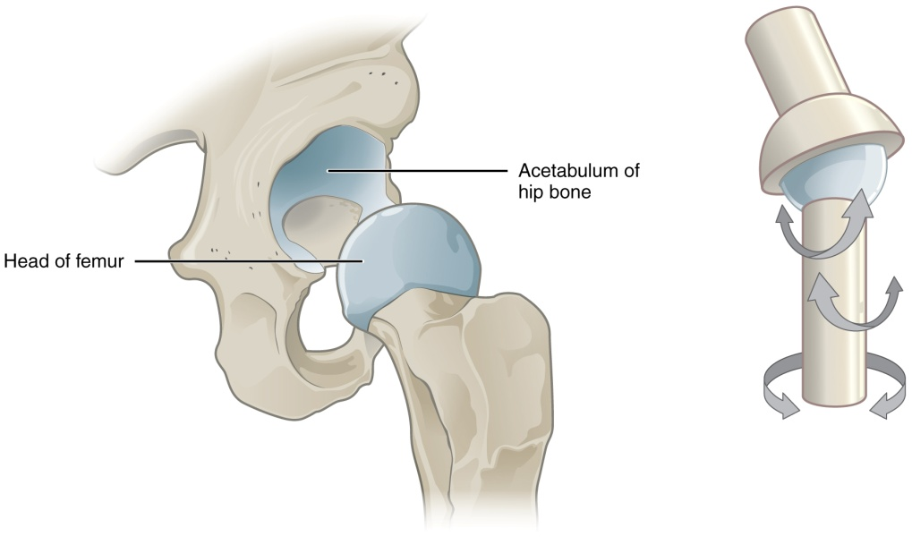
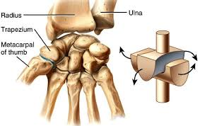
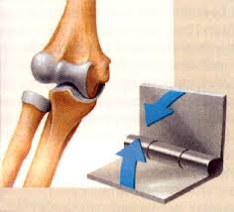
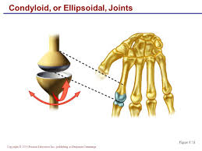
Some are completely moveable
Sinovial joints

Slide 8
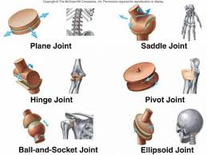
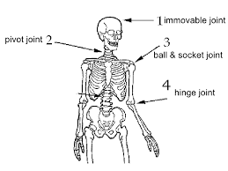
Sinovial Joints are also classified by how many directions they can move

Slide 9
Hinge joint
Moves in 2 directions
Eg. Knee or elbow

Slide 10
Ball and socket joint
Moves in all directions. It’s also called a universal joint
Eg. Hip or
shoulder

Slide 11
Pivot joint
Turns or an axis
Eg. radius or neck

Slide 12
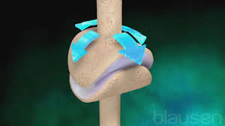
Saddle joints
Move in an arc
forward and back as well as side to side
Eg. fingers

Slide 13
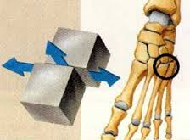
Gliding joints
Move on a flat plane
Forward and back as well as side to side
Eg. between short bones in the wrist and ankle
Between vertebrae

Slide 14
Ellipsoidal joints
Very flexible joints not quite as flexible as a ball and socket but almost
Between hand and fingers
Also found in your neck

Slide 15
The relative of movement of the joint is also important
Muscles can only contract to move a joint.
Another muscle moves it back.
Muscle work in antagonistic (opposite) pairs
Joints can flex or extend
Joints can abduct or adduct
Joints can rotate in two directions

Slide 16
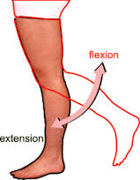
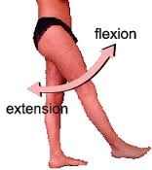
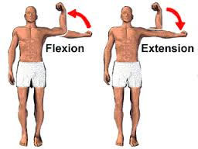
Flexion/Extension
When the angle at the joint gets smaller it’s flexion.
When the angle at the joint gets bigger it extension.

Slide 17
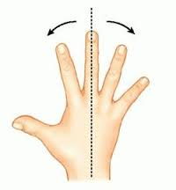
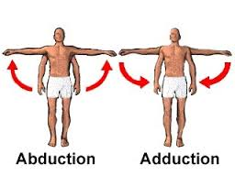
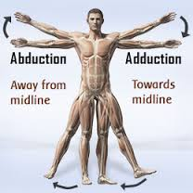
Abduction/ Adduction
When you move the limbs away from the midline you Abduct them (kidnap or steal away)
Bringing them close to the midline is Adduction.

Slide 18
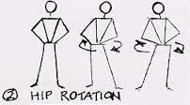
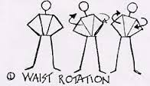
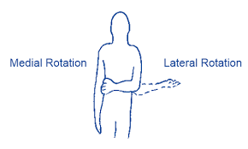
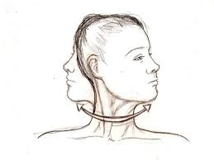
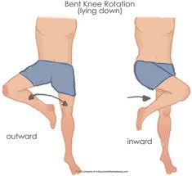
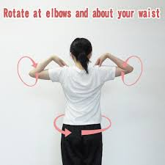
Rotation
When the joints can turn on an axis left and right or up and down this is rotation

Slide 19
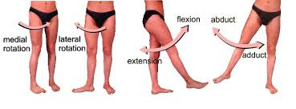
Universal joints
Your hips and shoulders are ball and socket joints. They can do all the movements.

