Slide 1
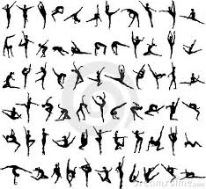
Types of synovial joints
Immoveable
Semi-moveable
moveable

Slide 2
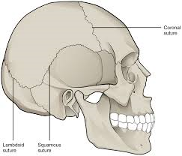
Immoveable joints
These joints surround and protect vital body parts.
Skull

Slide 3
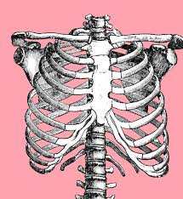
Semi-moveable joints
These surround and protect vital organs but can move a little bit.
Eg. Rib cage. It protects your heart and lungs but also moves so you can breathe.

Slide 4
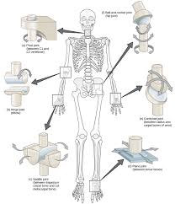
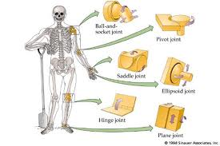
Moveable joints (sinovial joints)
These joints link your bones together and allow you to move.
They are mostly in your limbs and spine.
There are several types of synovial joints depending on how they moved.

Slide 7
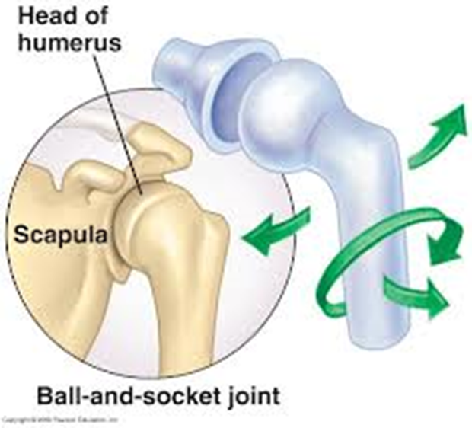
Ball and socket
Ball and socket
Or universal joint
Moves freely in all
directions

Slide 8
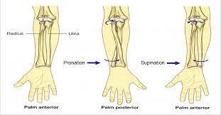
Pivot joint
Moves radially
Spins on a axis
Eg. Radius
Or top of neck

Slide 9
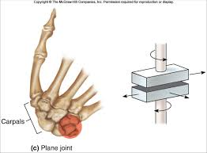
Gliding joint
Occurs between two flat surfaces
Short bones or vertebrae
Bones move in 2 planes
And can pivot

Slide 10
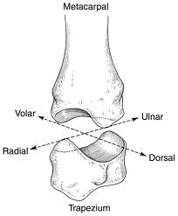
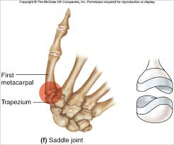
Saddle joints
Saddle joints provide a curved movement forward and back as well as side to side. They join you wrist to your hand bones

Slide 11
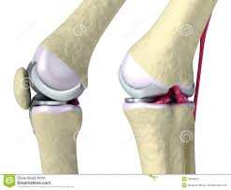
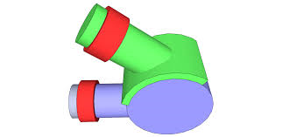
Hinge joint
These joints move forward and back in one direction only like your knee and elbow

Slide 12
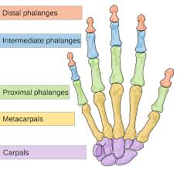
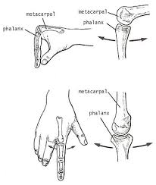
Condyloid joint
These joints are some times called ellipsoidal
They work like a joy stick
You can bend and wag

Slide 13
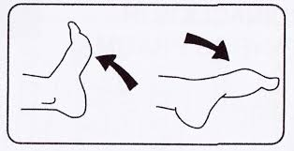
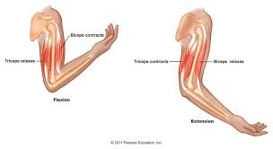
Types of movements Types of movement in a joint always go in opposite pairs
Flexion: the angle of the joint gets smaller.
Extension: the angle of the joint gets bigger.

Slide 14
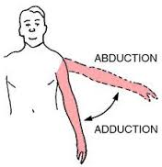
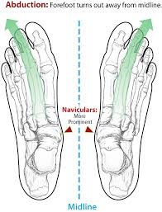
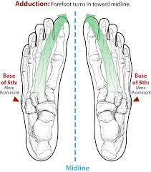
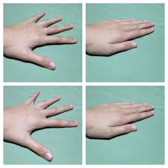
Abduction: Limbs move laterally away from central torso.
Adduction: Limbs move medially close to the central torso

Slide 15
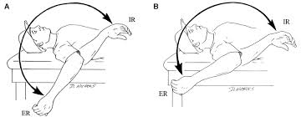
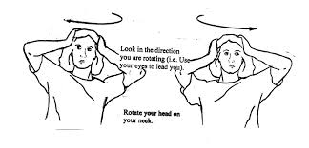
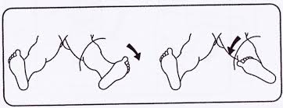
Rotation
The joint can spin in either direction on an axis.
This can be 360⁰ like in your shoulder or hip
Or 180⁰ or less as in your wrist or ankle

