Slide 1
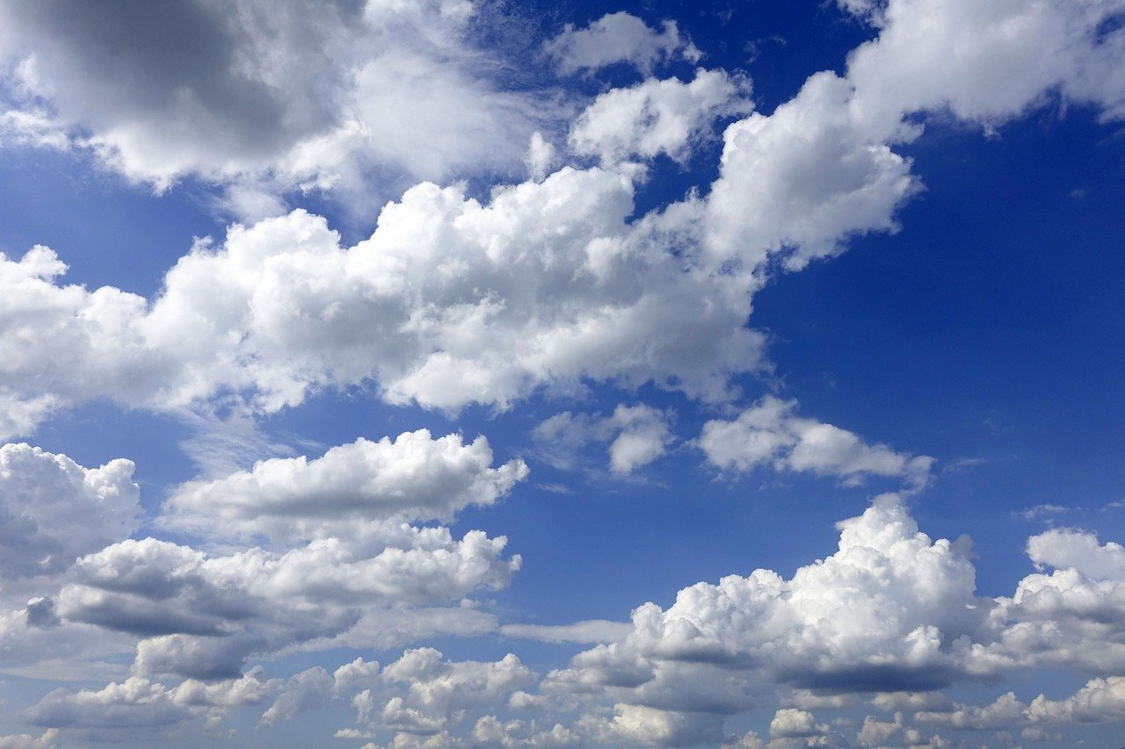
Wind and Weather
Density, convection currents and the water cycle…..
AGAIN

Slide 2
What is energy?
Energy is the ability to do work.
Energy is what makes change happen.
The sun is our ultimate source of energy.
It makes weather happen by driving the water cycle
It makes wind by causing different air densities

Slide 3
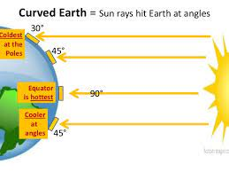
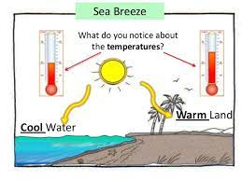
Density
The sun hits the earth
the earth heats up unevenly
The equator heats more than the poles because of the angle of the sun
Land heats up faster than water
This causes a difference in density

Slide 4
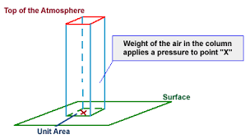
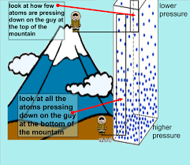
Density and Air Pressure
Gravity pulls all the air particles towards the earth
Air particles are matter they have mass
Your hand can hold up a column of air that has a mass of 150Kg
This is called air pressure. Normal air pressure at sea level is 101.3 kPa
At the top of a mountain the air is less dense
The pressure is lower
At the bottom of the mountain the air is denser
The pressure is higher
.

Slide 5
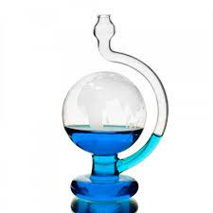
How do scientists measure air pressure? With a barameter. Low pressure (hot moist air rising) predicts rain. High pressure (cold dry air falling) predicts fine weather

Slide 6
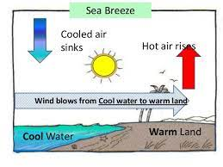
Heat and density and air pressure
Hot air expands and becomes less dense and rises
This causes lower pressure
Cold air compresses and becomes more dense and falls
This causes higher pressure

Slide 7
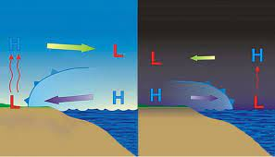
Sea breeze versus land breeze small convection currents
Day time land heats quickly
Water heats slowly
Wind blow on shore wind blows off shore
Nighttime water cools slowly
land cool quickly
Wind blows off shore

Slide 8
What is wind Air always flows from high to low
When air is rising (low pressure) it leaves a space.
Nature abhors a vacuum so….
Air rushes in from high pressure areas it fill the space.
Moving air is wind.
Air always flows from high to low.

Slide 9
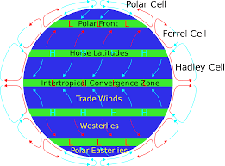
This works on a global scale too
Air rises at the equator (Low P)
and sinks at the tropic of cancer
(High P)
Air rises at the arctic circle (Low P)
and sinks at the poles (high P)
Air always flows from high to low

Slide 10
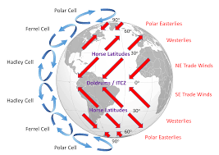
Coriolis affect winds bend
Surface wind blows from high to low
But the earth is always
spinning under the wind.
This makes it look like the wind is bending
It gives us our prevailing wind
Where we live in the northern hemisphere our winds come from the west

Slide 11
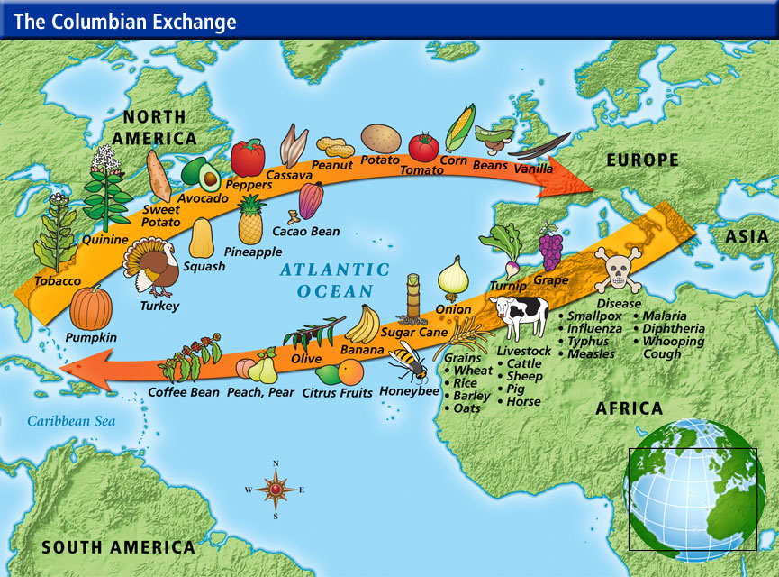
Trade with Europe followed the prevailing wind so does the weather
Sailing ships from Europe would bring slaves from Africa on the easterly trade winds
And carry cotton, sugar, coffee, rum, fish, and chocolate back the northern route on the westerly winds

Slide 12
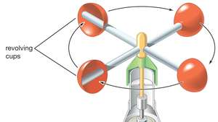
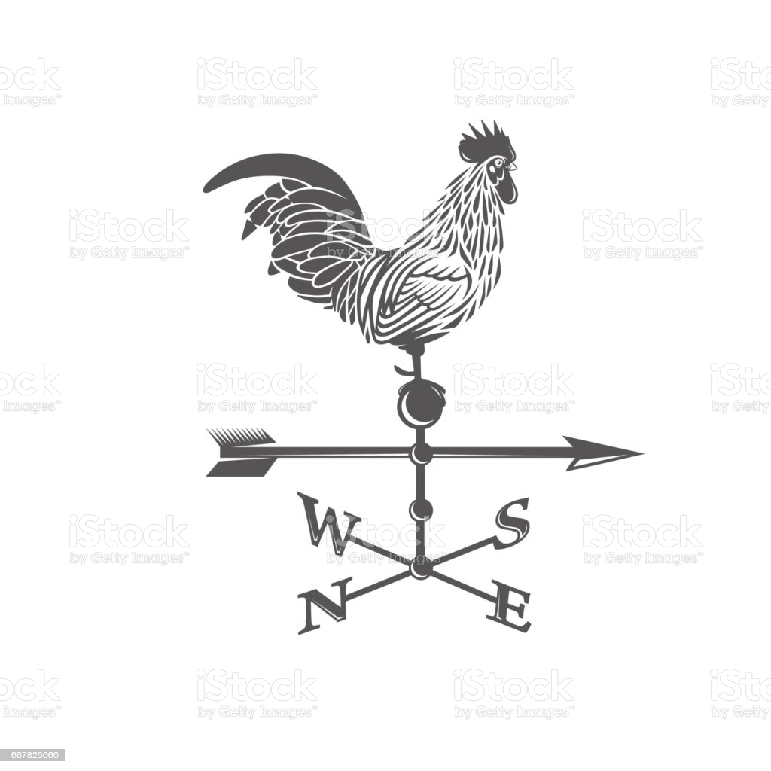
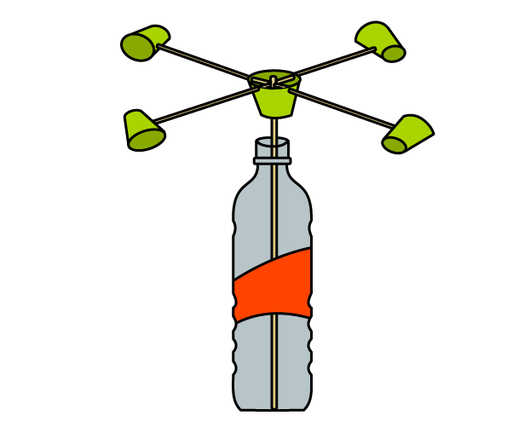
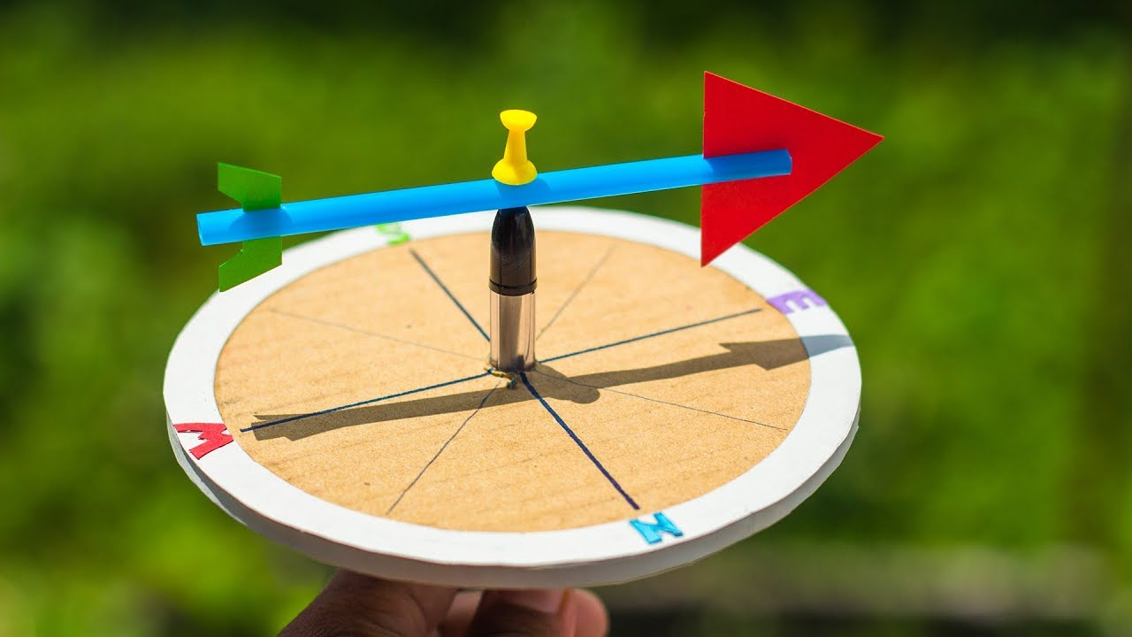
How do scientists measure wind speed and direction?
An anemometer is used for wind speed
A weathervane is used for wind direction

Slide 13
Homework measure the relationship between air pressure, temperature and rain fall
Record the temperature and atmospheric pressure for Greenfield Park every day for 1 week.
Note which days there is rain or snow
Put your data in a table
Make a line graph let date be the X axis (independant variable)
Let pressure be the Y axis (dependant variable)
Make a second Y axis on the graph for temperature
When the pressure is low what happens to the temperature?
When the pressure is high what happens to the temperature?
When does it rain? When the pressure is low or high?

Slide 14
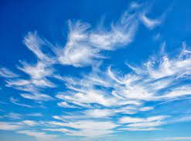
The water cycle density and clouds air is like a sponge it holds water
Warm air is less dense it soaks up water
When warm moist air rises it carries water vapor up higher in the atmosphere.
The temperature gets cooler and denser and squeezes the water out.
The water condenses on pieces of dust or ice particles
And forms clouds

Slide 15
Clouds are formed at different altitudes and each one predicts a certain kind of weather.

Slide 16
Cirrus clouds form on ice crystals high in the air . They look like mare’s tails. They predict rain in 2-3 days

Slide 17
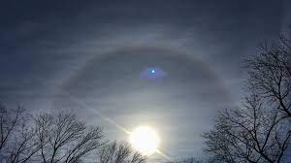
Cirrostratus cloud form a high layer. The number of stars you can see inside the ring predicts the number of days until rain or snow

Slide 18
Cirrocumulus clouds form a high fluffy layer. They are sometimes called a maceral sky. They predict rain in 8-10 hrs. After a rain they predict good weather

Slide 19
Altostratus clouds are blue grey and cover the whole sky at a medium height. They predict the weather is going to change. A long continuous storm(either rain or snow) is on the way

Slide 20
When alto stratus clouds clump together, they make Nimbostratus clouds. These are big and bulky and produce lots of rain. Nimbo means rain

Slide 21
Altocumulus clouds mid height fluffy layer. Altocumulus clouds on a warm humid morning means thunderstorms in the afternoon

Slide 22
Stratocumulus low level fluffy layer of clouds Usually there is no rain but sometimes if thick they can bring drizzle

Slide 23
Cumulus clouds. Theses are low clouds that look like fluffy balls of cotton they predict fine weather and bright sunny days

Slide 24
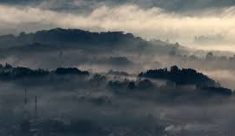
Stratus clouds
Low lying grey clouds can be off the ground fog.
Usually there is no rain but sometimes there is drizzle.
Often they burn off by 10AM

Slide 25
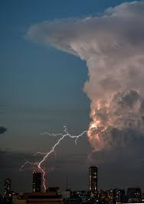
Cumulonimbus or thunder heads
the biggest clouds of all.
They start close to the ground and grow into towering heaps up to 11km high. They are the lowest and highest clouds.
The tops are shaped like a big anvil or a hammer head called a thunder head.
Theses clouds are filled with strong up currents of air and
Produce massive rainstorms, thunder and lightening, hail, and even tornadoes

Slide 26
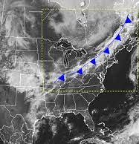
What is an air mass? What happens when 2 air masses come together?
An air mass is a giant body of air
With the same temperature and humidity characteristics.
Maritime air mass is cool and moist
Tropical air mass is warm and moist
Continental air mass is warm and dry
Arctic air mass is cold and dry
Each air mass has its own density.
When air masses meet they make a front.

Slide 27
There are 4 main kinds of fronts
They depend on:
the types of air masses and
the direction the 2 air masses are moving.

Slide 28
Weather symbols for the 4 fronts

Slide 29
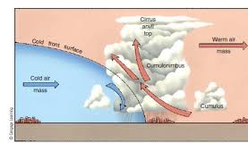
Cold front .
Both air masses are moving in the same direction
The cold front passes very quickly

Slide 30
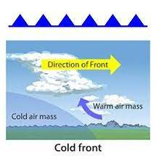
Fronts can predict weather
Cold front cold air mass pushes towards a warm air mass
Cold dense air falls and warm moist air is pushed up.
Cumulonimbus clouds form.
When a cold front passes there are brief rain showers, sometimes thunder showers
then the temperature drops and there is fine weather,

Slide 31
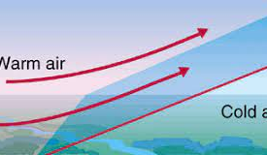
Warm front again
Both air masses are moving in the same direction
The warm front can be hundreds of miles long and passes slowly

Slide 32
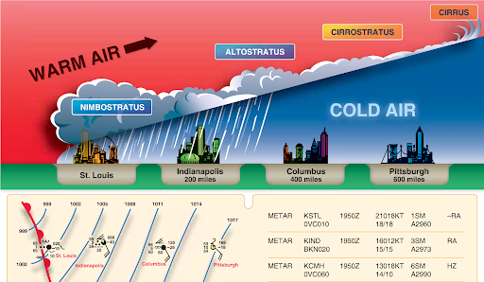
Warm front
The warm air rises slowly in a wedge.
First you get cirrus clouds
Then cirrostratus
Then stratus and nimbostratus with a long period of rain
When the front passes the temperature rises quickly
The wind direction changes
The weather clears

Slide 33
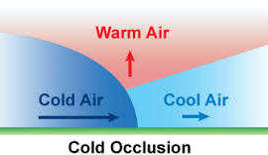
Occluded front
three air masses are moving in the same direction.
a cold air mass catches up to a cool air mass and push the warm air up.
Traps the warm air above.

Slide 34
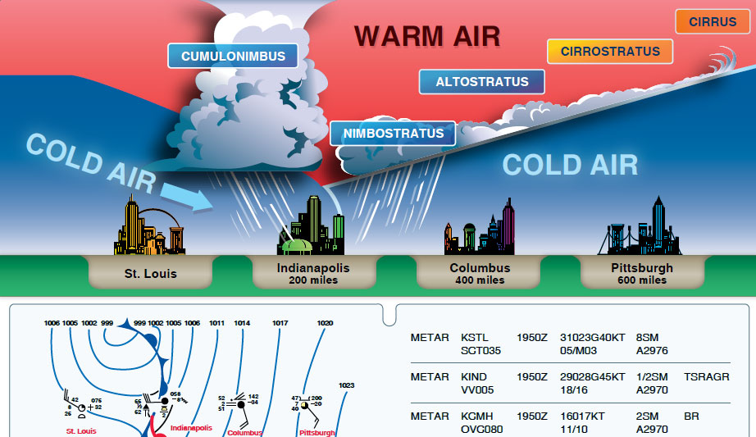
Occluded front
One side looks like a warm front the other side looks like a cold front.
There is lots of rain on both sides of the front.

Slide 35
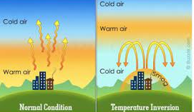
An Inversion Front
Sometimes you look over to the city and you can see all the yellow pollution hanging in the air. It smells bad too.
This is called a temperature inversion
It happens when the air is still.
It is caused when a warm layer of air is trapped over a cold layer and keeps all the pollution close to the ground.
It can happen in the summer or the winter

Slide 36
Stationary front
Two air masses are going in opposite directions.
A warm air mass bumps into a cold air mass.
They hold their position.

Slide 37
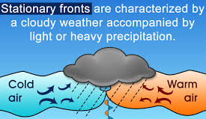
Stationary front
The weather is cloudy and stable
Ususally there is rain
It could be light or heavy precipitation.

Slide 38
We have over 200 years of recorded weather data and thousands of years of folklore predicting weather
Your job is to research a piece of folklore and find out if it is true and why?
Make a power point. Use lots of nice pictures. Your presentation should take 5 min.
Be sure to mention:
Air pressure
Humidity
Clouds
Temperature
Weather fronts
Prevailing winds

Slide 39
Folk lore Whether the weather be fine or whether the weather be not; Whether the weather be cold or whether the weather be hot; We’ll weather the weather, whatever the weather, whether we like it or not!
Red sky at night sailors delight. Red sky in morning sailors take warning
Rainbow in the east storm approaching. Rainbow in the west fine weather
From the ditches odors rise soon rain is going to fill the skies
If the crow flies low the winds gonna blow. If the crow flies high the winds gonna die
If you squash a spider, you will make it rain
The number of stars inside the ring around the moon will predict the number of days til it rains.
A halo around the sun or moon means snow or rain is coming soon.
When rain is on the way old sheep turn their back to the wind, cats sneeze, and cows lie down.
If the ground hog sees it’s shadow, then then there will be six more weeks of winter.
Mist at seven sun by eleven.
Leaves flip over before it rains.
People with arthritis say that their joints hurt before it rains.
Hurricanes
Tornados

